Slide 1
18 03 24
canolfan
Ble mae’r ganolfan hamdden?
Notes:
Mawrth/March – Wythnos 3
Canolfan – centre
Ble mae’r ganolfan hamdden? – Where is the leisure centre?

Slide 2
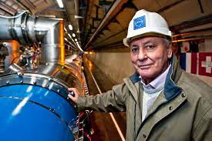
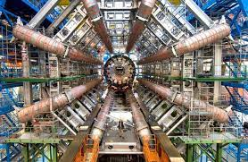
18 03 24
Lyn Evans, CERN
Gwyddonydd Cymreig o Aberdâr
Fe oedd cyfarwyddwr canolfan ymchwil niwclear CERN yn Genefa yn y Swistir
Mae wedi derbyn nifer o wobrau am ei arweinyddiaeth yn y maes
A Welsh scientist from Aberdare
He was director of CERN nuclear research centre in Geneva, Switzerland
He’s received many awards for his leadership in the field
Notes:
Nov – Week 2
Candelas

