Slide 1
Sixth Form Handbook
For Students and Parents

Slide 2
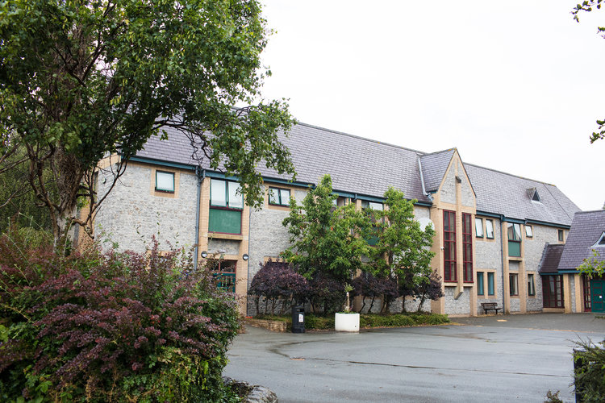
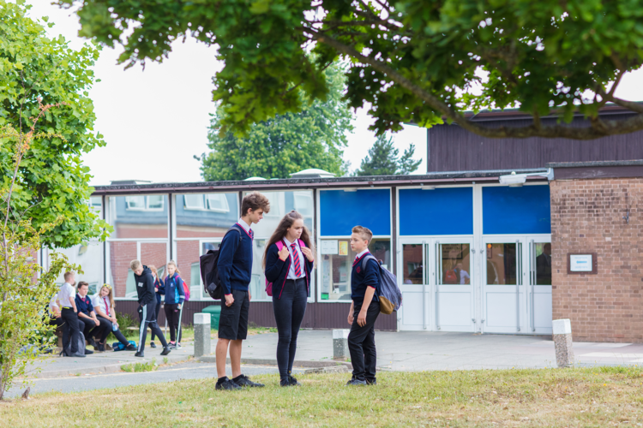
Introduction Key Staff Post 16 Expectations Support in the Sixth Form Mentoring and Monitoring Progress Attendance and Rules Opportunities UCAS process Useful websites Other helpful resources
Contents
The School at the heart of Wales
College Rd, Builth Wells, Powys, LD2 3BW Dyffryn Rd, Llandrindod Wells, Powys, LD1 6AW
office@caloncymru.powys.sch.uk office@caloncymru.powys.sch.uk
01982 553292 01597 822992

Slide 3
Congratulations on your GCSE Results and welcome to the Sixth Form at Ysgol Calon Cymru. We believe in a Sixth Form that not only strives for academic excellence but that is central to the vitality of the school. We aim to develop sixth-formers who are visible leaders throughout the school and we are delighted that you will be joining us. This programme will include registration, an initial meeting with the Head of Year, peer mentoring training, study skill sessions with a university, and an introduction to the WBQ at KS5. Finally, we recognise that communication between school, student, and parent is one of the keys to success in the Sixth Form. We try not to send a paper copy of any correspondence where we have an email address, so please ensure that the school has up-to-date email and contact information for your parent/career. We believe that as 6th Formers it is your responsibility to take charge of your learning as you prepare for this next stage of life, this is why attendance to registration is vital to pick up important announcements and receive the support on offer from your form tutors. It is also essential that you are checking your school emails and TEAMS on a daily basis. Attendance to lessons is also crucial as it has been proven time and time again that those students attending lessons regularly increase their chances of success significantly. We look forward to welcoming you to the Sixth Form at Ysgol Calon Cymru and hope that you make the most of the opportunities available over the next two years. Yours sincerely, Mrs Tiernan and Mrs Derhe
Introduction
The School at the heart of Wales
College Rd, Builth Wells, Powys, LD2 3BW Dyffryn Rd, Llandrindod Wells, Powys, LD1 6AW
office@caloncymru.powys.sch.uk office@caloncymru.powys.sch.uk
01982 553292 01597 822992

Slide 4
Tîm Arwain CA4
KS5 Leadership Team
Pennaeth y Chweched Dosbarth
Head of Sixth Form
Mrs Lizzie Tiernan
Deputy Head of Sixth Form
Dr Ffion Price
Gwienyddwr y Chweched Dosbarth
Sixth Form Administrator
Mrs Lia Price

Slide 5
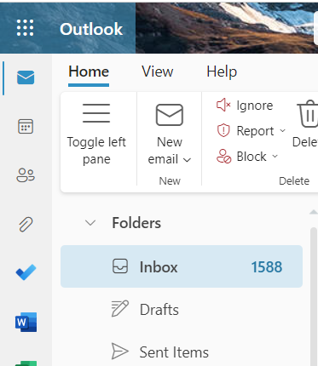
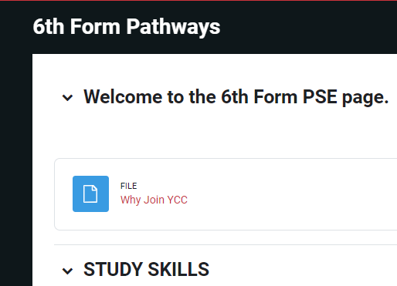
Go4Schools, Email, TEAMS, Website & Moodle
Gwnewch yn siŵr eich bod wedi logio mewn i Go4Schools. Ar y wefan hon gellir tracio cynnydd, presenoldeb ac ymddygiad eich plentyn (ymddygiad da a drwg). Ceir modiwl gwaith cartref hefyd lle y gellir darparu mwy o ddogfennau / manylion i gefnogi tasgau gwaith cartref lle bo angen.
Please ensure that you have logged on to Go4Schools. Here you will be able to keep track of your child’s attendance, progress and behaviours (both positive and negative). There is also a homework module where staff will provide more detail / supporting documents where applicable to the homework task.
Check TEAMS and HWB email daily for notices and important messages
https://www.ysgolcalon.cymru/sixth-form
Check out the website regularly for current news and events for the Sixth Form
https://vle.caloncymru.powys.sch.uk/enrol/index.php?id=500
Moodle is our point of reference for 6th form Pathways, RSE, study skills, and resources for students

Slide 6
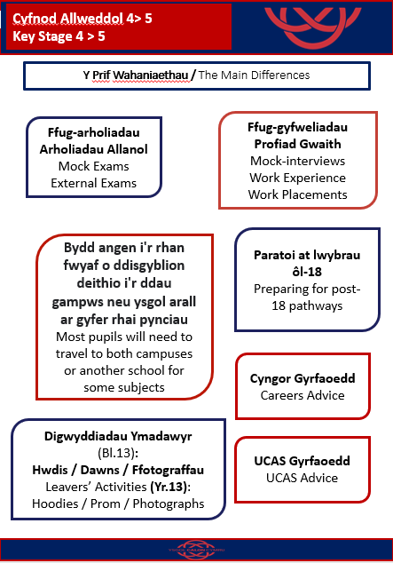

Slide 7
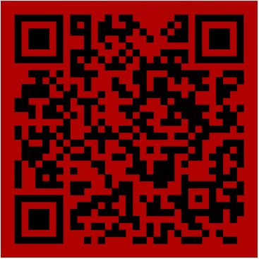
Chweched Powys Sixth
We are part of the Chweched Powys Sixth consortium across Powys. Therefore you can complete all your A levels at YCC or if you wish to access an A level course with a different provider, you can as long as it fits within the pathways.
The Pathway for YCC is below for the 2023-2025 cohort.
You can apply for a course through the website: https://powys6.cymru/home or via the QR code.
Most students take three A levels plus the Welsh Baccalaureate, which is a full A level in itself. This is a valuable qualification, which often provides a contextual offer at Universities. If a student wishes to study 4 separate subjects in exceptional circumstances, they need to speak to the Head of Sixth Form.
Transport is provided between sixth forms and between campuses at YCC. You will also be issued with a bus pass as there may be times when you will be required to catch the service bus. This is available from school.
All students are expected to wear their Chweched Powys Sixth lanyards at all times for safeguarding reasons across all schools.

Slide 8
Cysylltu â'r ysgol - Pryd a Phwy?
Contacting the School – When and Who?
Yn union fel y mae’n anodd gwybod sut i gyflawni cydbwysedd rhwng cynnig gormod o gefnogaeth i’ch plentyn (a chael eich cyhuddo o ffysan) a’u gadael i ymbalfalu ac efallai methu, mae’r un mor anodd cyflawni cydbwysedd rhwng bod yn “rhiant orbryderus’ a gadael i bethau fynd yn eu blaenau’n rhy hir am nad ydych am ymyrryd.
Mae’r gwaith tipyn haws os ydych yn dal ati i siarad â’ch plentyn ynglŷn â sut y mae pethau yn yr ysgol. Chi sy’n adnabod eich plentyn orau, ac os yw unrhyw agwedd o fywyd yr ysgol yn eu gofidio’n brahaus diau mai’r peth gorau yw bod yn orofalus ac ymyrryd yn gynnar trwy gysylltu â ni yn yr ysgol.
Rydyn ni wedi creu rhestr e-byst athrawon a staff er mwyn i chi gysylltu â’r aelod o staff mwyaf priodol yn hawdd.
Just as it is hard to know how to achieve the balance between offering your child too much support (and being accused of fussing) and leaving them to flounder and perhaps fail, it is also hard to achieve the balance between becoming the ‘over anxious parent’ and letting things go on too long because you don’t want to interfere.
The job is made much easier if you keep talking to your child about how things are at school. You know your children best, and if any aspect of school life is persistently distressing them it is probably best to err on the side of caution and intervene early by contacting us at the school.
We have created a comprehensive contact list so that your concerns can be directed to the most appropriate person.
For all sixth-form absences please ensure you contact Mrs Lia Price to explain why you are absent and your subject teachers for that day and you are expected to ask for work to enable you to catch up. If you do not let us know the reason for your absence, a text message will be sent home to inform parents of the missed lessons.

Slide 9
Contact Details
Llandrindod Campus | Builth Campus
Headteacher Mr. R Jones | Headteacher Mr. R Jones
Deputy Headteacher Mr. L Powell | Deputy Headteacher Mr. L Powell
Head of Campus Ms R Rhys-Jones rhys-jonesr5@hwbcymru.net | Head of Campus Mr L. Jones jonesl3097@hwbcymru.net
Head of Sixth Form Mrs E Tiernan tiernane6@hwbcymru.net | Deputy Head of Sixth Form Dr Ffion Price pricef146@hwbcymru.net
6th Form Administrator Mrs L Price pricel466@hwbcymru.net | 6th Form Administrator Mrs L Price pricel466@hwbcymru.net
Form Tutors Mrs A Jones Year 12 Mrs M Mackenzie Year 13 | Form Tutor Mrs J Edwards
Exam Officer L Davies | Exam Officer J Healey
Additional Learning Needs Coordinator Mrs V Phillips phillipsv22@hwbcymru.net | Additional Learning Needs Coordinator Mrs V Phillips phillipsv22@hwbcymru.net
General Enquires office@caloncymru.powys.sch.uk | General Enquires office@caloncymru.powys.sch.uk

Slide 10
Contact Details

Slide 11
We hope you will find the Sixth Form to be a friendly and welcoming environment in which you are encouraged to develop a sense of independence and to take responsibility for your studies, to prepare for your adult life and next steps after Sixth Form. The next two years will be very important ones in shaping your future career and education, and one of our fundamental aims is to help you decide what you want to do after ‘A’ levels and then work with you to secure the necessary grades, qualifications, and experience needed for your chosen objective. The Sixth Form, however, is more than just a finishing school for university. It offers you a chance to start developing the study skills, personal qualities and time management that you will need in later life. It provides opportunities for you to develop extra curricular and sporting interests, or to discover new ones. Your time in the Sixth Form will pass very quickly, and it is important that you adjust to the demands of advanced level learning as soon as possible. You must realise that learning is not a passive activity in the Sixth Form and you can’t just expect to turn up to lessons and hope that your teacher will do all the work for you. As you are studying subjects you have chosen, teachers will expect this to be reflected in your approach to work which should be both positive and well organised (ie no late or incomplete assignments!). More than at GCSE, you will be expected to carry out independent study, especially reading around the subject and completing extra exercises, whilst in class teachers will expect you to be active and willing to participate in discussions. For a period of two years in the Sixth Form, you will be given considerable freedom and responsibility, yet within a secure framework of support and guidance. You will be able to identify your own interests and strengths and build upon them by concentrating in depth on the subjects you enjoy. Your initiatives will be welcomed and you will be recognised as a leader of the school community and given opportunities to develop your social and leadership skills. Generally you will be given more freedom and privileges in the Sixth Form. However, these carry responsibilities. Whatever course you are embarking on, one of the most valuable attributes that you can acquire is self-discipline. When you leave the Sixth Form to enter employment or higher education you will find considerable account is taken of this maturity. Qualifications alone will not tell anyone if you get on with other people, whether you are reliable and can work in a team. They will not say whether you are an enthusiastic or lethargic member of society. The best students in the Sixth Form are not necessarily those who are the cleverest; they are those who realise that full involvement in every aspect of Sixth Form life will bring their talents to fruition. To a great extent the character of a school depends on the quality of its Sixth Form, which should take the lead. We hope you will play your full part, achieve success on your chosen course, and enjoy your time in the Sixth Form. The Sixth Form is an exciting time, make the most of it!
Post 16 Expectations

Slide 12
Progress, Dropping subjects, further advice and support, and UCAS/Careers If you are considering changing courses then you should discuss your plans with your Progress Leader. A change of this kind must not be made lightly and you are strongly advised not to change courses beyond the first 5 weeks of term as too much ground will have to be made up. Only if we are satisfied that you have thought through all the issues surrounding a change of subject, and discussed them with your parents, will you be allowed to make a subject change. You will need to complete a Course Change/dropping Form which must be completed by yourself and signed by your parent/guardian. It is vital that you complete this form and return it to the Progress Leader or you will be invoiced for exam entries in that subject. Progress and Monitoring Subjects are delivered across both campuses and you may find that all your lessons are on one campus for a subject, or they are split. A levels are demanding. You are expected to attend all lessons (4 hrs a week per A Level) as well as carry out an additional 4 hours of your own study per A Level. Assignments and set work must be submitted on time and to the required standard. If on a rare occasion, there is a problem with a deadline, you should see the subject teacher concerned. Since you are studying fewer subjects, you will find that you have ‘free’ lessons. Unfortunately, this does not mean that you have nothing to do. If you feel you are up to date, you should make use of the Independent study guides available for each subject The proper use of private study periods is an essential part of your management of time. It is only too easy to let these periods drift by without anything positive being achieved. The social facilities available in the Block should be used sparingly and sensibly and the IT and study area are seen as a quiet working environment! If you do experience difficulties, you should immediately seek advice from your subject teacher or your Head of Sixth Form or Progress Leader.. Progress is monitored on a regular basis throughout the course. Central to monitoring progress and providing direction is the mentoring system and individual action planning. You are encouraged to consider possible future career paths, research requirements in terms of qualifications, skills, and experience, and devising strategies to obtain them. We believe that success is achieved by maintaining a partnership between you, your parents, and the school. To this end we keep parents informed of your progress through regular reports and Parents’ Evenings. Progress, attendance, punctuality, attitude, and effort are monitored throughout your course and any concerns will be addressed by your Head of Sixth Form or Progress Leader. If the problem is one of organisation of your work, for example, letting things pile up, missing deadlines or not making efficient use of your study periods, then your form tutor is available to help. Keep checking TEAMS and emails daily to keep up to date with vital announcements and upcoming school calendar events.
Support in the Sixth Form

Slide 13
Support in the Sixth Form
Course Support: Student is put on course support if subject teacher raises concern over progress.
Firstly: Subject teacher raises concern with student and intervention/ support is agreed on and progress monitored for fortnight . HOS/ PL informed.
Second action point: If concern continues over progress, Subject teacher now incorporates support of HOD, intervention and support is agreed on and progress monitored for fortnight. Initial contact is made with home to raise concern. HOS/ PL informed.
Third action point: Concerns continue, referral to HOS/ PL. Student meets with Progress Leader to discuss progress concerns with the involvement of feedback from subject teacher and HOD to decide on the best agreed action forward and progress in monitored for fortnight.
Fourth action point: If concerns continue, Progress Leader or Head of Sixth Form (and where possible HOD/ Subject teacher) meets with student and parents to discuss progress concerns and decide on agreed action forward and monitored.
Student Improves
Student removed from Course Support
Referral to SLT
Meeting with Head of Sixth Form. Possible removal from course depending on circumstances

Slide 14
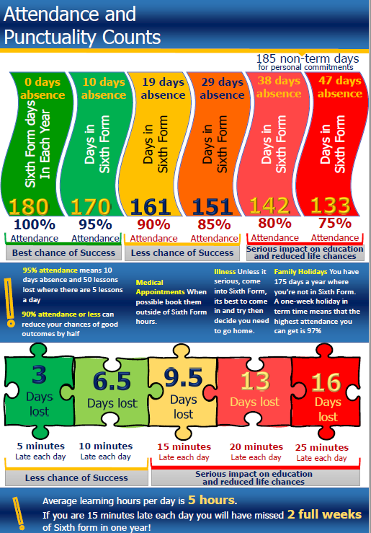
Attendance & Punctuality

Slide 15
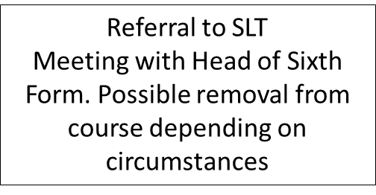
Course Support: Student is put on course support if subject teacher raises concern over attendance.
Firstly: If a student is absent without reason, parents will receive a text. Please respond to the text and ensure a reason is provided for absence and that the student catches up on work missed. If the student emails Mrs L Price and staff with the reason, there will be no text sent home.
Second action point: If a student’s attendance in any lesson drops to below 85% without good reason, the subject teacher contacts home to discuss and records contact home on G4S.
Third action point: Concerns continue and attendance to any subject drops below 80% without good reason, subject teacher is to report to L Price, and a letter is sent via email home to arrange a Parent meeting with the Progress Leader / Head of Sixth Form to discuss concerns.
Fourth action point: If concerns continue, the Progress Leader or Head of Sixth Form (and where possible HOD/ Subject teacher) meets with the student and parents to discuss attendance concerns and decide on agreed action forward and monitored.
Student Improves
Student removed from Course Support

Slide 16
Attendance and punctuality Students are expected to attend all lessons on their timetable including the extended tutorial. Students are welcome to stay for the whole day. And use the study rooms and facilities for independent study. Students are encouraged to attend work placements if linked to the career path and only in consultation with parents and Progress Leader. If that student begins to underachieve, the work placement option could be withdrawn. You are permitted to leave the school site during breaks and study periods. However, if you are to make effective use of your time, it would be advisable to spend the majority of this time in one of the designated Study Areas. If you do leave the school site, you must sign out at the School office or Sixth Form Centre. Absence You must notify Mrs L. Price and your subject teachers via email if you are unable to attend school. You should also request work from your teachers to catch up on work missed. The content level of A/S level courses is very high; it is important that you do not miss lessons. Appointments with a doctor, dentist, and like- where possible should be made out of lesson time. Driving lessons should not be arranged when you have timetabled lessons. A driving test is an acceptable absence. Requests for absence to attend University Open Days will normally be granted, but all requests should be made to Mrs L. Price. Students are not expected to take holiday time during term time. Permission must be sought for exceptional circumstances such as a family wedding. Poor attendance may be used as grounds for asking you to leave the Sixth Form. Mobile phones We recognise that many of you have mobile phones for security reasons. However, to avoid unnecessary disruption you must ensure that mobile phones are switched off during all lessons, assemblies, and other formal occasions. Mobile phones may only be switched on or used in the social area of the Sixth Form Centres. Personal stereos, CD players, iPods, mp3s, etc may also only be used in the Sixth Form Centre – NOT around the school. Dress code We expect members of the Sixth Form to dress in smart casual clothes appropriate for a place of work and study. This means that the following are NOT allowed: inappropriate logos, crop tops, ripped jeans, ‘cut off’/ casual T-shirts and shorts. We also expect an appropriate level of discretion in terms of the amount of ‘skin’ on view so strappy vest tops are also not allowed. Lanyards MUST be worn at all times whilst on any Chweched Powys Sixth Form including YCC. Transportation If you are having issues with your bus pass, taxi or other general transportation issues your first point of contact is Mrs. L Price. Organisation, Time management, Study Skills, School Calendar, Advice and Support If the problem is one of organisation of your work, for example, letting things pile up, missing deadlines or not making efficient use of your study periods, then your form tutor is available to help. Also, it is the Sixth Form staff Team who will keep you up to date with vital announcements and upcoming school calendar events. Exam Entries, Resits and Results Exam Officer Builth Campus: J Healey Llandrindod Campus: L Davies
Support in the Sixth Form

Slide 17
Student Pathways
Careers support throughout Sixth Form
YEAR 12: Induction week- introduce taster A-level lessons, NetSixthForm transition lessons, introduction to VESPA, and talk by Cardiff University- What a sixth former needs to look like to cope with Higher Education. VESPA work throughout years 12 and 13. Careers Fair and UCAS Fair. UNIFROG sessions to identify VISION. TED-X Event - Ai technology and plagiarism, writing personal statements, careers of the future, CV workshop, apprenticeships, employers interactive stands, Big Ideas Wales. 1 week Work Shadowing Placement for the career of choice- access to database and local opportunities wanted.
YEAR 13: UCAS and Apprenticeships covered using NetSixthForm, UCAS and UNIFROG. UCAS applications 2024: work on UCAS and Personal Statements will be embedded into compulsory PSE early from March to October 2023 to avoid Deadline Mode and Panic Mode. Mock interviews- to be held in January. Parents meeting in July to support students. Those applying for apprenticeships will continue to be supported and apply in April. All those still unsure are offered careers interviews with Careers Wales Advisor.
Evolution of the UCAS Personal Statement- you need to be able to provide evidence that you can demonstrate these aspects of your application to University or Apprenticeships
Motivation for course: Why do you want to study these courses?
Preparedness for course: How has your learning so far helped you to be ready to succeed on these courses?
Preparation through other experiences: What else have you done to help you prepare, and why are these experiences useful?
Extenuating circumstances: Is there anything that the universities and colleges need to know about, to help them put your achievements and experiences so far into context?
Preparedness for study: What have you done to prepare yourself for student life?
Preferred learning styles: Which learning and assessment styles best suit you – how do your courses choices match that?
It is essential that you make the best use of opportunities available to you in order to support your applications to University, apprenticeships or work. We will signpost you to many options for you to consider to support you.

Slide 18
Work Placements We offer all year 12 students the opportunity to complete a work shadowing week in July. In addition, we encourage students to take up a work placement if they have space in their timetable for a half or full day a week to complement their education and support their applications for Higher Education. Voluntary unpaid work placements are highly valued by Universities and Employers alike. We encourage students to find their own placement, but the staff team are also able to help secure placements if required. Sixth Form Leadership Sixth Form is led by a Head Team on each site, but leadership is not limited to those who have an official role or title. We encourage all to take an active role across the school and show initiative. If you are interested in supporting particular activities led by the Head Team (e.g. charity work, socials, yearbook, etc) please make sure you make them and Progress Leader aware and get involved! Sport All sixth formers can access a wide range of school sports facilities with permission from the PE staff. You can also play a major role in the coaching of younger pupils as well as helping with the school Sports Day. The emphasis is always on participation and enjoyment and you will be encouraged to pursue as wide a range as staff and facilities allow. Facilities and staffing permitting, you are welcome to do PE in your study periods. All sixth formers have reduced monthly membership to the MRC Gym in Llandrinod during school hours. https://www.movementrecreationculture.com/ . Also, there is an opportunity to participate in Gold Duke of Edinburgh Award, please see Mrs. Tiernan for more information regarding this. Socials, Proms and Trips At Ysgol Calon Cymru we believe that you invest in what you enjoy, and believe that creating opportunities to remember and make the most of your Sixth Form experience is important as well. The Head Team leads up planning socials throughout the year and the prom in year 13. There is also an opportunity for a number of trips related to the study (e.g. 6th Form Expedition to Morocco, RE Trip to New York, PE Ski Trip, Humanities trip to Berlin, Geography fieldwork, etc) , as well as reward trips at the end of the year to celebrate a year of all your hard work! Charities Under the supervision of the Sixth Form Head Team, the Sixth Form plays a central role in our charity work. You will help organize various charity events and assemblies including Christmas Charity Week. Peer Mentoring / Well Being Champions/ Prefects As part of your school service and an incredible opportunity to give back to the community of the school, all Sixth Formers are encouraged to take part in the peer mentoring programme and/or to volunteer as a Prefect to support staff with duties at break and lunchtime once a week. This is not only an opportunity to give back but to develop your own leadership skills. Community Challenge Each Year 12 will need to complete 30 hours of community service, it is highly recommended that you consider your community project as something that contributes to the wider life of the school. Such activities could include: Weekly lunchtime club (Film, arts, sports, etc) Subject support Peer mentoring Lunchtime supervision / Prefect duty
Opportunities for Student Pathways

Slide 19
Where to start? Where parents, carers, and guardians can help:
Being a soundboard
Choosing where to study for three years - especially if it’s far away from home - can be an overwhelming prospect. Children and young people often need to talk things through with someone they trust who will listen to their thoughts and concerns. Parents, carers, and guardians normally know their children well enough to offer guidance and have experience of how they work, what they enjoy, and where they excel. They’ll also be able to advise them against a potentially bad decision for them without the barriers that can exist between teachers and pupils. Remember though that listening is much more important than advising - have a look at our section on when to take a step back to find out more.
Offering support
Applying to university can be stressful and quite daunting. For some children and young people, the added pressure of the application deadline on top of exams and any part-time jobs or extra-curricular activities can be quite overwhelming. And with one in four students suffering from mental health problems according to a report by YouGov, one essential role for any parent or carer is to provide emotional support to prepare their child for a smooth transition into student life. Parents and carers can also support children and young people with their studies by providing a quiet space where they aren’t interrupted while they’re revising. If this isn’t possible at home, schools can offer after-school use of the library, or signpost families to their local libraries and help them register. Parents and carers should also have a copy of their child’s revision timetable to help keep them on track and to give them a starting point to talk with them about what they’ve been learning. Taking an interest in the subjects children and young people are passionate about will give them confidence and show them that they have someone in their corner.

Slide 20
Open Days
Some children and young people get loads out of going to an open day alone: it puts them outside of their comfort zone, it forces them to ask questions and get involved, and it means they end up talking to other prospective students in the same way they might when they actually start university. For others, though, having the support and comfort of someone they know with them who can also talk about the experience with them afterwards, makes the day that much better and easier to process. If parents or carers do accompany their children, encourage them to get the child or young person to plan the day: when they should leave home, where they should visit, which talks to go to, and which questions to ask. Ultimately, it’s the child or young person who will be studying there; all the parent or carer needs to do is be present and for most children and young people, that’s enough to give them the confidence to make decisions about the institutions they visit. “It’s very hard for one person to attend an open day on their own and get a full picture of what a university is like. However, it’s about encouraging students to ask the questions, rather than the parents saying everything.” (Mike Nicholson, director of admissions at the University of Bath)
Being open about finance
With 64% of university students worried about their finances according to Future Finances in 2016, parents and carers can ease the pressure by being honest and upfront when it comes to discussing finance. This can be challenging, especially in strict or traditional families where discussing money is seen as taboo. Being honest and open, however, doesn’t mean sharing bank statements and annual salaries; it’s more about setting the expectation of what parents and carers are able to give to their children, and what they’re not, and teaching them how to budget effectively.

Slide 21
Some children and young people will be able to receive financial assistance to fund their studies through a bursary or scholarship, so they need to know if they qualify for schemes that are aimed at students from low-income families. They should also know whether or not they’ll need to look for part-time work while they’re studying as this might affect the accommodation, university, or even the city they choose. Schools can support families with this by inviting in speakers to talk about student finance and scholarships options, and by teaching budgeting skills in PSHE or enrichment sessions.
When giving advice
Listening and helping children and young people organise their thoughts is great, but giving advice can be slippery. Some parents and carers are misinformed about what it means to go to university or which universities are ‘worth’ going to, some have traditional views on courses and industries, and some hold outdated views on alternative progression routes. These ideas can be detrimental to children and young people’s choices and to their well-being - you don’t want to add potentially upsetting their family to their long list of stresses. Some children and young people aren’t suited to university life for lots of different reasons, some will want to take a subject that they excel at even if it doesn’t lead directly into a career, and some will want to explore alternative opportunities to university. Demanding that children and young people do something they don’t want to do isn’t helpful and may lead to them being miserable at university, or even dropping out of their course completely. Schools should encourage parents to listen to what children and young people want and to what their teachers think they are capable of achieving in any route they choose. Schools can also arrange for speakers to come in to talk to parents about apprenticeships, degree apprenticeships, school

Slide 22
leaver programmes, and other progression routes. Unifrog hosts a range of webinars for students on these topics that parents might also find useful.
When proofreading
Children and young people definitely need a trusted family member, friend, or teacher to read their Personal Statement, but parents and carers should avoid editing the document directly or writing/finishing the application for their child. Not only does this take the responsibility off of the child or young person applying, but if they are called for an interview and don’t know what’s in their Personal Statement or if it is discovered that someone else has written their application, they can risk losing offers or even their place at university. Parents and carers should not be given direct access to their child’s UCAS profile or Unifrog account; they may make changes that the child or young person does not agree with, or send items off before they are ready. Parents and carers can actually have their own Unifrog accounts so they can explore to help their child; this will not only help ease any tension but will also make children and young people more willing to share their work so far as it’s on their terms.

Slide 23
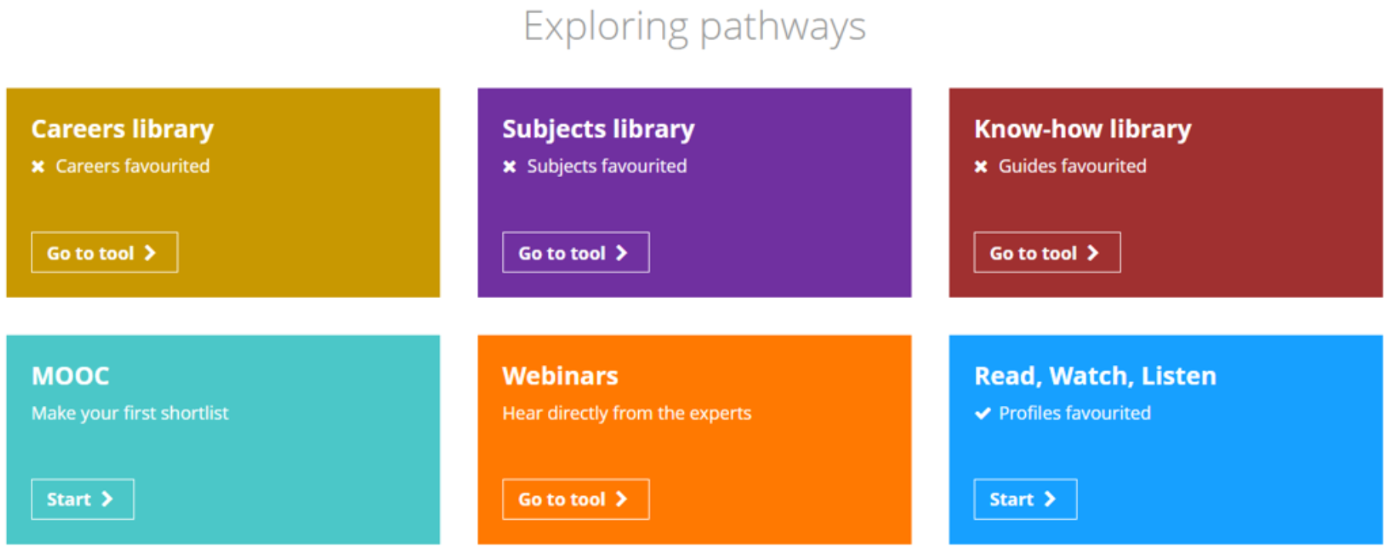
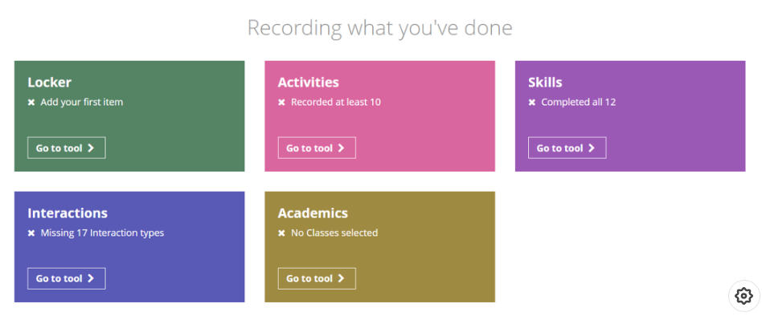
Independent Learning and Study
VESPA links vision with goals which lead to High Vision-High Effort Thrivers or Low Vision- Low Effort Divers. Therefore finding the goal and inspiring students to find a career path that inspires them is the key to successful students. Subject-specific links to careers encouraged to raise awareness from KS4 into KS5.
Regular VESPA psychometric testing supports personal interventions for engagement in learning,
Unifrog is the package we use to support students in their University and Apprenticeship applications. Students explore careers, courses and have access to a vast library of independent study resources to demonstrate an understanding of their chosen careers path and knowledge beyond the A-level curriculum. All additional interactions can be recorded and evidence to support Higher Education applications and make our students stand out from the thousands of applicants to courses.

Slide 24
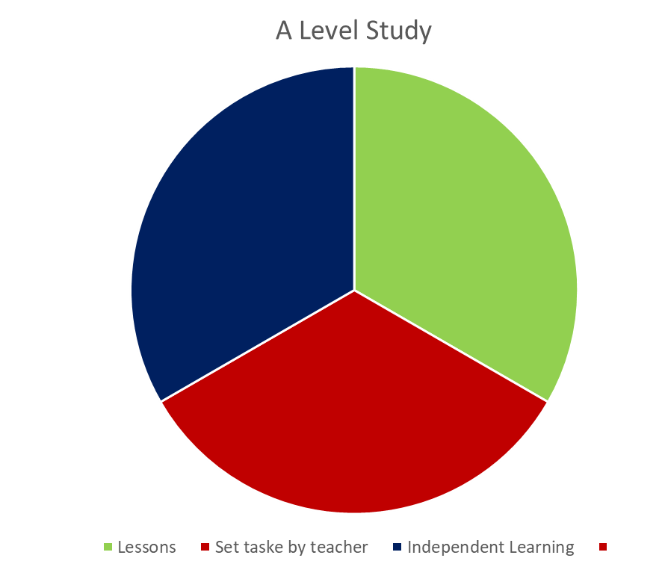
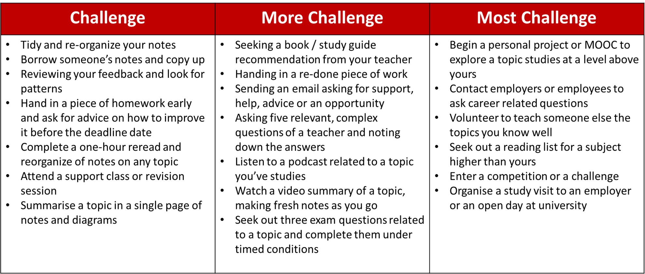
Independent Learning and Study
How different are lessons in the Sixth Form?
Your teachers may set a pre-learning task or prior reading before the lesson. ie make notes / watch a video and make notes/research a topic. The lesson will focus on the work covered in the pre-lesson task but look at understanding and how to answer exam questions.
More independent learning is expected from you.
Entirely reactive | Mostly reactive Proactive on rare occasions | A balance of reactivity and proactivity | Some reactivity, but mostly proactive
These students only complete work if they’re told to. They’ve often never set themselves any work – even in the run-up to exams, they go to extra classes and react to the instructions they get there. | These students complete almost all their work because they’re told to. Now and again, if there’s a crisis, they’ll spend a small amount of time proactively – revising for a test or tracking down some missing notes. | These students are close to matching their reactive work with proactive work. They’re regularly setting themselves work; re-reading and tidying notes, asking questions, reading textbooks and submitting redone essays. | These students get their reactive study out of the way pretty quickly, completing it to a high standard so they can get on with more proactive work. They enjoy the proactive work, exploring topics in detail and challenging themselves.
Outcomes: These students almost always get the lowest grades in the year group. | Outcomes: These learners find themselves towards the bottom of most groups, but have the potential to climb up. | Outcomes: These students tend to be in the middle or towards the top of most of their classes. | Outcomes: These students are almost always at the top of their classes, and often end up getting places at the best universities.

Slide 25
2023-24 Autumn term: Monday 4 September 2023 to Friday 27 October 2023 Half Term - Monday 30 October 2023 to Friday 3 November 2023 Monday 6 November 2023 to Friday 22 December 2023 Spring term: Tuesday 9 January 2024 to Friday 9 February 2024 Half Term - Monday 12 February 2024 to Friday 16 February 2024 Monday 19 February 2024 to Friday 22 March 2024 Summer term: Monday 8 April 2024 to Friday 24 May 2024 Half Term - Monday 27 May 2024 to Friday 31 May 2024 Monday 3 June 2024 to Friday 19 July 2024 Non-pupil days: Friday 1 September 2023 Friday 22 December 2023 Monday 8 January 2024 There will be three further non-pupil days, two in the autumn term and one in the summer term. Please check your school website for these details Cluster Inset Days 2023-24 (PDF) [139KB] Useful dates: Good Friday - Friday 29 March 2024 Easter Monday - Monday 1 April 2024 May Day Bank Holiday - Monday 6 May 2024 Spring Bank Holiday - Monday 27 May 2024 Royal Welsh Show - Monday 22 July - Thursday 25 July 2024

Slide 26
2024-25
Autumn term:
Monday 2 September 2024 to Friday 25 October 2024
Half Term - Monday 28 October 2024 to Friday 1 November 2024
Monday 4 November 2024 to Friday 20 December 2024
Spring term:
Monday 6 January 2025 to Friday 21 February 2025
Half Term - Monday 24 February 2025 to Friday 28 February 2025
Monday 3 March 2025 to Friday 11 April 2025
Summer term:
Monday 28 April 2025 to Friday 23 May 2025
Half Term - Monday 26 May 2025 to Friday 30 May 2025
Monday 2 June 2025 to Monday 21 July 2025
Non-pupil days:
Monday 2 September 2024
Monday 6 January 2025
There will be three further non-pupil days, one per term, agreed on a cluster basis. Please check your school website for these dates.
Useful dates:
Good Friday - Friday 18 April 2025
Easter Monday - Monday 21 April 2025
May Day Bank Holiday - Monday 5 May 2025
Spring Bank Holiday - Monday 26 May 2025
Royal Welsh Show - Monday 21 July - Thursday 24 July 2025

Slide 27
Supporting my child if I don’t speak Welsh
Cefnogi’m plentyn os nad wyf yn siarad Cymraeg

Slide 28
Supporting my child if I don’t speak Welsh
Cefnogi’m plentyn os nad wyf yn siarad Cymraeg

Slide 29
Wellbeing Support
Mind
Lorna Jones
Mental Health Wellbeing and Support
youth@mnpmind.org.uk
Rhai gwefannau / adnoddau defnyddiol: Some other useful websites/resources:
TiKTok – Parents Safety Centre
NSPCC – TikTok and top tips for staying safe
South West Grid for learning
Safer Internet Centre
Internet Matters
GetSafeOnline
Online Bullying
Yr asiantaethau cymorth y mae'r Heddlu'n gweithio gyda yw:
The support agencies the Police work with are:
www.actionforchildren.org.uk
www.MeicCymru.org
www.thinkuknow.co.uk
www.talktofrank.com
www.cais.co.uk

Slide 30
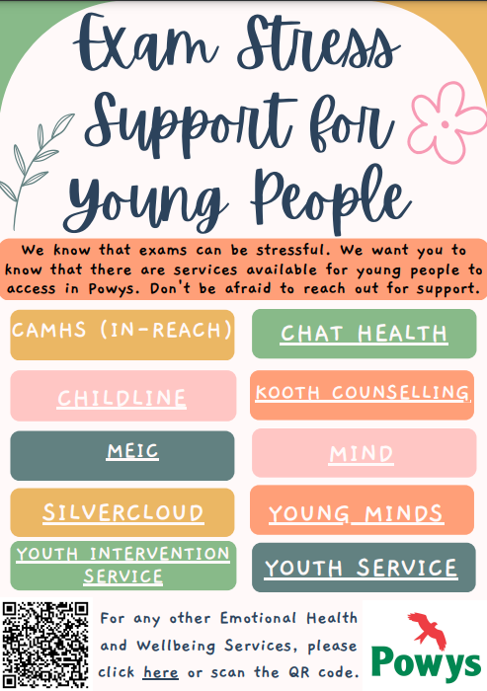
Wellbeing Support

Slide 31
Wellbeing Support

Slide 32
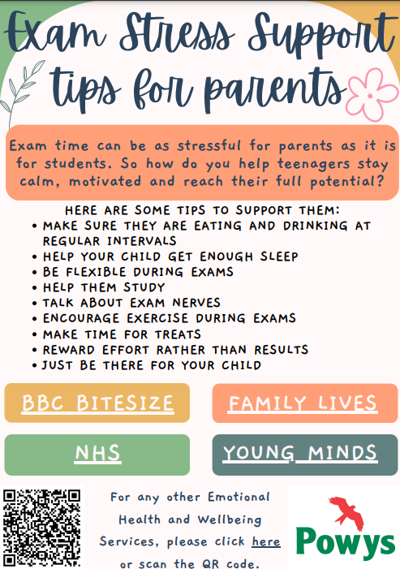
Wellbeing Support

Slide 33
Wellbeing Support

Slide 34
www.wjec.co.uk Make sure you know what is required. Plan ahead. Know the examination dates etc. We sit the WJEC examinations. Be a regular visitor to their website. https://www.wjec.co.uk/question-bank/ https://www.wjec.co.uk/home/past-papers/ https://www.eduqas.co.uk/home/past-papers/ Build your own past paper by using WJEC and EDUCAS past papers and question bank Not sure what you want to do? www.informedchoices.ac.uk Careers/ Jobs: https://nationalcareersservice.direct.gov.uk/ http://www.careerswales.com/en/ http://jobseekers.direct.gov.uk www.fish4.co.uk www.jobswales.co.uk http://jobsearch.monsterwales.com www.powys.gov.uk, www.indeed.com Higher Education: https://www.ucas.com/ https://www.myheplus.com/ www.ukcoursefinder.com www.unistats.co.uk www.yougo.co.uk www.prospects.ac.uk Chemistry http://www.chemguide.co.uk/ http://www.s-cool.co.uk/alevel/chemistry.html http://www.docbrown.info/page13/page13.htm http://www.knockhardy.org.uk/sci.htm Physics: http://www.wjec.co.uk/index.php?subject=96&level=21 Geography www.geogonline.org.uk French www.languagesonline.org.uk Mathematics www.MathsRevision.net www.mathcentre.ac.uk www.scool.co.uk www.examsolutions.co.uk http://furthermaths.org.uk Religious Studies https://resources.wjec.co.uk/Pages/ResourceByArgs.aspx?subId=26&lvlId=1 https://getrevising.co.uk/ Other https://www.studentfinancewales.co.uk/
Useful Websites
www.informedchoices.ac.uk

Slide 35
University Youtube channel https://www.youtube.com/user/BristolUWE https://www.youtube.com/user/cardiffuni UCAS https://www.ucas.com Universities on Twitter to follow #cambtweet Webinars ‘Ted talks’ Reading, READING and more reading! (no substitute here really, ask your subject teachers for suggested reading list!) You can access most university libraries for free!

