Slide 1
Gradients and the Rate of Change
Grade A/A*
Understand that the gradient at a point on a curve is the instantaneous rate of change, and apply the concepts of average and instantaneous rate of change (gradients of chords and tangents) in contexts (numerical, algebraic and graphical)

Slide 2
Key Vocabulary
Gradient
Curve
Rate of change
Instantaneous
Tangent
Average
Differentiation
Derivative

Slide 3
How to calculate instantaneous rate of change
We can calculate the instantaneous rate of change by calculating the gradient of the curve at one point.
The gradient of a curve changes at each point so how can we calculate the gradient?
e.g. Calculate the instantaneous rate of change of the curve y = x² + 2x + 2 when x=0.
Draw a tangent to the curve at the point (0, 2)
Calculate the gradient of the tangent
Gradient of tangent = instantaneous rate of change
instantaneous rate of change = 6/3 = 2

Slide 4
How to calculate instantaneous rate of change
Given the equation y=2x³ + 3x what is the instantaneous rate of change at x = 2?
We now know that the rate of change refers to the gradient so we can use differentiation to solve the question
y = 2x³ + 3x
dy/dx = 6x² + 3
When x = 2,
dy/dx = 6(2)² + 3 = 27

Slide 5
How to calculate average rate of change
e.g. Calculate the average rate of change of the graph of y = 2x² – 2 between x = 1 and x = 3/2
Here, we need to calculate the average gradient between these two points
We use the formula;
average rate of change = (y₂ - y₁)/(x₂ – x₁)
Where (x₁, y₁) and (x₂, y₂) are two points on the curve
Our two points are (1, 0) and (1.5, 2.5)
Average rate of change = (2.5 - 0)/ (1.5 - 1) = 5

Slide 6
How to calculate instantaneous and average rate of change – Now you try …
The graph shown is of y = - 1/(x - 3)
a) Calculate the instant rate of change at x = 0
b) Calculate the average rate of change in the interval [0, 0.5]
a) Instant rate of change = (1-0)/(6 - -3) = 1/9
b) (0, 1/3) and (0.5, 0.4)
Average rate of change = (0.4 – 1/3)/(0.5 - 0) = 2/15

Slide 7
How to calculate instantaneous and average rate of change – Now you try …
f(x) = √x ; Find f’(144)
f(x) = x² – 6x – 2; Find f’(-14)
Find the equation of the tangent line to the curve f(x) = 3 – 4x² at the point where x = 1
f’(x) = 1/2√x f’(144) = 1/2√144 = 1/24
f’(x) = 2x – 6 f’(-14) = 2(-14) – 6= -34
f’(x) = -8x f’(1) = 18
Eqn of the line with gradient = 18 through (1, -1) is
y- -1 = 18 (x - 1)
y + 1 = 18x -18
y = 18x - 19

Slide 8
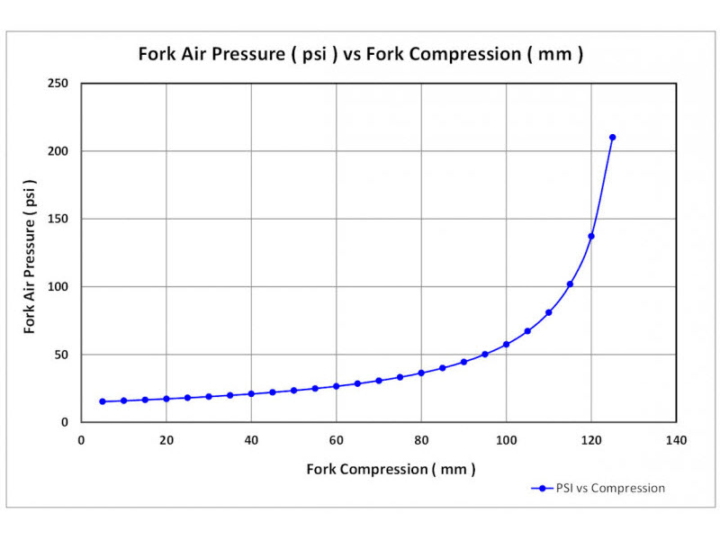
Problem Solving and Reasoning
Using the graph, calculate the instantaneous rate of change when the fork compression is 60 mm
Rate of change = 50/120 = 5/12

Slide 9
Reason and explain
Consider the equation y = 2x³ + 3x² - 1. At what values of x is the instantaneous rate of change equal to zero?
What is the gradient of the line x=-2482?
Find the x-values where the function does not have a derivative.

