Slide 1
Algebraic Fractions
Grade 6
Simplify algebraic expressions involving algebraic fractions.

Slide 2
Key Vocabulary
Factorise
Simplify
Quadratic
Linear
Collect

Slide 3
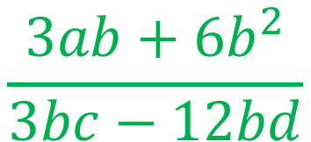
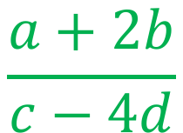
How to simplify an algebraic fraction
Look for common factors in each of the terms.
Simplify the factors to the lowest possible for each term.
$$\frac{3ab+6b^{2}}{3bc−12bd}$$
Each of the 4 terms in the fraction have a multiple of 3.
They also have a ’b’.
So each term can be divided by 3 and b.
There is nothing else common in all 4 terms so this is complete.
1
2
$$\frac{3ab+6b^{2}}{3bc−12bd}$$
1
4
$$\frac{a+2b}{c−4d}$$

Slide 4
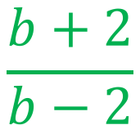
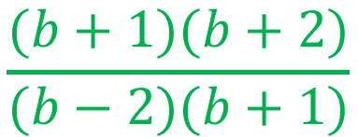
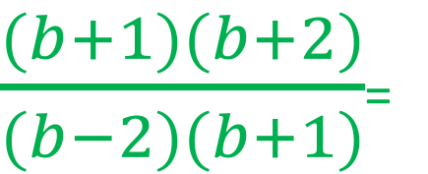
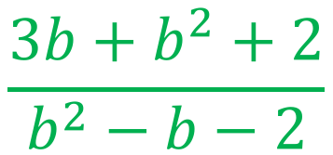
How to simplify an algebraic fraction (2)
Look for multiples of a number of letter in every term –if there are not any, can you factorise the expressions?
Simplify the factors to the lowest possible for each term.
$$\frac{3b+b^{2}+2}{b^{2}−b−2}$$
Both of the terms are quadratic in terms of b.
They can both be factorised.
Both have a complete identical bracket so it can be cancelled out in the numerator and denominator.
$$\frac{(b+1)(b+2)}{(b−2)(b+1)}$$
$\frac{(b+1)(b+2)}{(b−2)(b+1)}$=
$$\frac{b+2}{b−2}$$

Slide 5

Practice
Write the algebraic fractions in their simplest terms.
$\frac{12ab}{4a}$
$\frac{2ab−8abc}{{2a}^{2}b+4abc}$
$\frac{x^{2}+7x+6}{x^{2}+8x+12}$
$\frac{{2x}^{2}+7x+6}{{2x}^{2}−7x−10}$
$\frac{{3x}^{2}+17x+10 }{{3x}^{2}−x−2 }$

Slide 6

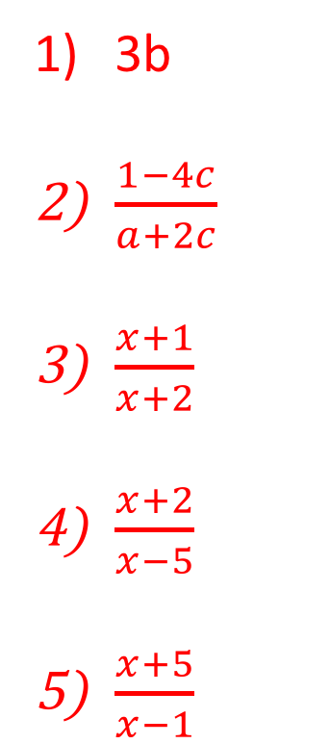
Practice
Write the algebraic fractions in their simplest terms.
$\frac{12ab}{4a}$
$\frac{2ab−8abc}{{2a}^{2}b+4abc}$
$\frac{x^{2}+7x+6}{x^{2}+8x+12}$
$\frac{{2x}^{2}+7x+6}{{2x}^{2}−7x−10}$
$\frac{{3x}^{2}+17x+10 }{{3x}^{2}−x−2 }$
3b
$\frac{1−4c}{a+2c}$
$\frac{x+1}{x+2}$
$\frac{x+2}{x−5}$
$\frac{x+5}{x−1}$

Slide 7
Reasoning. A rectangle has an area of ${4x}^{2}−7x−15$square units, its width is x-3 units. What is the length of the rectangle?

Slide 8
Reasoning. A rectangle has an area of ${4x}^{2}−7x−15$square units, its width is x-3 units. What is the length of the rectangle? Area $÷$width = length so:$\frac{{4x}^{2}−7x−15}{x−3}$ Factorise and simplify:$\frac{(4x+5)(x−3)}{x−3}$ The length is 4x+5 units.

