Slide 1
Factorising Quadratics where a>1
Grade A
Factorise a quadratic expression of the form ${ax}^{2}+bx+c$ , including the difference of two squares.
If you have any questions regarding these resources or come across any errors, please contact
helpful-report@pixl.org.uk

Slide 2
Key Vocabulary
Factorise
Binomial
Quadratic
Linear
Collect
Constant
Negative
Product

Slide 3
How to Factorise a quadratic expression
Factorising means to see what is a common multiple and put in brackets.
To factorise quadratics you need to start with your brackets and x terms.
$$x^{2}+10x+24$$
$$(x )(x )$$
To complete the brackets:
List the factors of 24
Find the ones that sum to 10
Put them in the brackets with + in the middle.
1 and 24
2 and 12
3 and 8
4 and 6
$$(x+4 )(x+6)$$

Slide 4
When the co-efficient of $x^{2}>1$
$${2x}^{2}+7x+6$$
To complete the brackets:
Multiply the first and last numbers:
Find a pair whose product is 12 and sum is 7.
Put them in the brackets, both with a $2x$
Can one of the brackets be simplified?
Cancel it down!
2x6=12
1 and 12
2 and 6
3 and 4
$$(2x+3)(2x+4)$$
$$(2x+3)(x+2)$$

Slide 5
What about a mixture of positive and negative numbers?
$${3x}^{2}−x−2$$
To complete the brackets:
Multiply the first and last numbers:
Find a pair whose product is 6 and sum is -1.
Put them in the brackets, both with a $3x$
Can one of the brackets be simplified?
Cancel it down!
3x2=6
1 and 6
2 and -3
$$(3x−3)(3x+2)$$
$$(x−1)(3x+2)$$

Slide 6
The difference of two squares
$${4x}^{2}−16$$
When it looks like the $x$ term is missing from the middle and both the firs and last term are squares and there is less work to do!
$$(2x )(2x )$$
To decide the number that goes in the brackets (it will be the same in each one), take the square root of the constant term (ie $\sqrt{16}=4$
One + and one -
$$(2x+4)(2x −4)$$

Slide 7
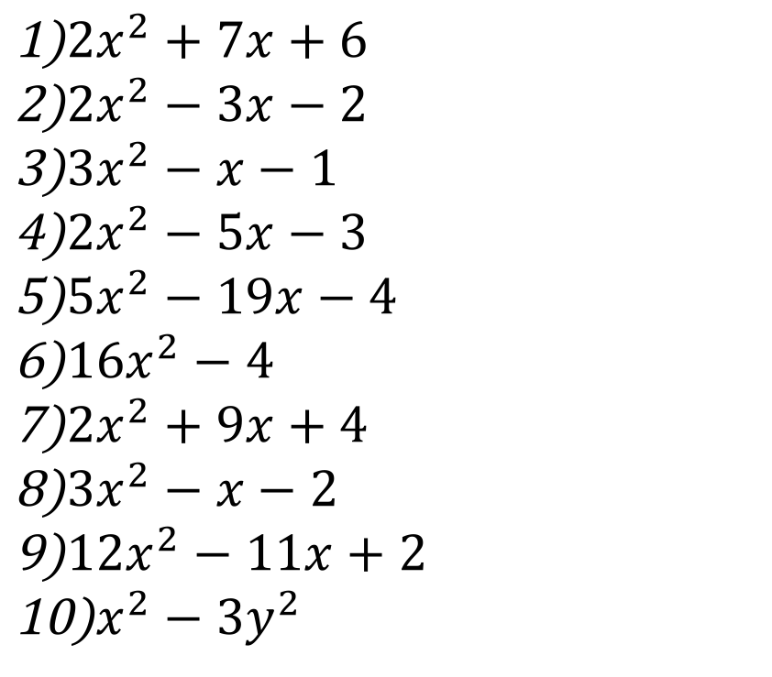
Practice
Expand the product of the 2 binomials in each of the following questions.
${2x}^{2}+7x+6$
${2x}^{2}−3x−2$
${3x}^{2}−x−1$
${2x}^{2}−5x−3$
${5x}^{2}−19x−4$
${16x}^{2}−4$
${2x}^{2}+9x+4$
${3x}^{2}−x−2$
${12x}^{2}−11x+2$
$x^{2}−{3y}^{2}$

Slide 8
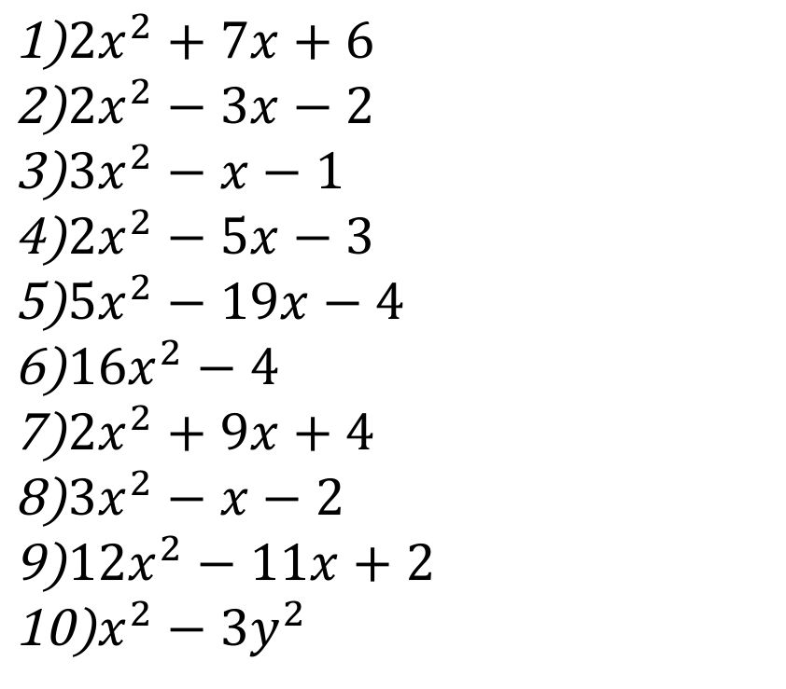
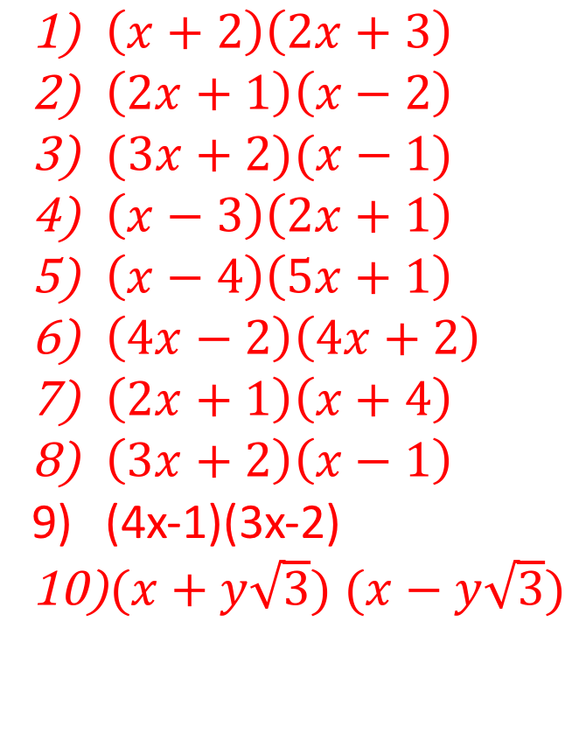
Practice
Factorise each of the quadratic expressions.
${2x}^{2}+7x+6$
${2x}^{2}−3x−2$
${3x}^{2}−x−1$
${2x}^{2}−5x−3$
${5x}^{2}−19x−4$
${16x}^{2}−4$
${2x}^{2}+9x+4$
${3x}^{2}−x−2$
${12x}^{2}−11x+2$
$x^{2}−{3y}^{2}$
$\left(x+2\right)\left(2x+3\right)$
$\left(2x+1\right)\left(x−2\right)$
$(3x+2)(x−1)$
$\left(x−3\right)\left(2x+1\right)$
$\left(x−4\right)\left(5x+1\right)$
$\left(4x−2\right)\left(4x+2\right)$
$\left(2x+1\right)\left(x+4\right)$
$\left(3x+2\right)\left(x−1\right)$
(4x-1)(3x-2)
$(x+y\sqrt{3})$ $(x−y\sqrt{3})$

Slide 9
Reasoning. A dining table has area ${8x}^{2}+2x−3$. What are the dimensions of the table and what shape is it?

Slide 10
Reasoning. A dining table has area ${8x}^{2}+2x−3$. What are the dimensions of the table and what shape is it? (8x )(8x ) 8x-3=-24 so 1,24 2, 12 3, 8 4, 6 can be the pairs 6-4=2 (8x+6)(8x-4) (4x+3)(2x-1) The sides are different so it’s a rectangle.

