Slide 1
Boxplots
Grade B
Interpret and construct box plots
If you have any questions regarding these resources or come across any errors, please contact
helpful-report@pixl.org.uk

Slide 2
Key Vocabulary
Lower quartile
Upper quartile
Median
Interquartile range
Boxplots

Slide 3
Drawing boxplots
To draw boxplots to represent a data set, we need to find 5 pieces of data:
Highest value
Upper quartile
Median
Lower quartile
Lowest value
Sometimes we are given these, but often we need to calculate them.

Slide 4
Quartiles and the median
If we put all our data in order, the lower quartile would be the 25th percent value, the median would be the 50th percent value and the upper quartile would be the 75th percent value.
The interquartile range shows the difference between the highest and lowest values of the middle 50% of values.

Slide 5
Finding the quartiles and median
We can use a cumulative frequency graph to find quartiles and the median (using grouped data), but this is treated in the Cumulative Frequency Therapy.
This Therapy looks at the case where you have a set of individual data values.
To find the median and quartile values we;
Put the data in order
Split the data into two equal halves. The middle value is the median.
Now find the middle value of each half. These values are the quartiles.
Interquartile range = Upper quartile – Lower quartile

Slide 6
Example 1
Given the values 1 2 3 4 5 6 7
Find the middle value 1 2 3 4 5 6 7
This leaves two sets 1 2 3 and 5 6 7
Finding the middle values of these 1 2 3 and 5 6 7
Median = 4
Quartiles are Lower Quartile = 2 Upper quartile = 6
Interquartile range = 6 – 2 = 4

Slide 7
Example 2
Given the values 1 2 3 4 5 6 7 8 9 10
Here the middle value is between two numbers. We take the mean average of these for the value of the median
1 2 3 4 5 6 7 8 9 10
This leaves two sets 1 2 3 4 5 and 6 7 8 9 10
Finding the middle values of these
1 2 3 4 5 and 6 7 8 9 10
Median = (5 + 6)/ 2 = 5.5
Quartiles are Lower Quartile = 3 Upper quartile = 8
Interquartile range = 8 -3 = 5

Slide 8
Example 3
Given the values 1 2 2 4 5 6 9 10
Here the middle value is again between two numbers
1 2 2 4 5 6 9 10
This leaves two sets 1 2 2 4 and 5 6 9 10
Here, the middle values are again between two numbers. We take the mean average of these for the values of our quartiles
1 2 2 4 and 5 6 9 10
Median = (4+5)/2 = 4.5
Quartiles are
Lower Quartile = Mean average of 2 and 2 = 2
Upper quartile = Mean average of 6 and 9 = 7.5
Interquartile range = 7.5 - 2 = 5.5

Slide 9
Drawing boxplots
First we need a scale (similar to an x-axis)
Then we draw 5 vertical lines representing the smallest value, lower quartile, median, upper quartile and largest value.
Finally we draw 4 horizontal lines forming a rectangle (box) with the quartiles and median, and connecting the box with the largest and smallest values.

Slide 10
Example
We are given the following information about the ages (in years) of students on an Open University course, and asked to draw a boxplot of the data.
Lowest age = 14
Highest age = 54
Median = 32
Lower quartile = =22
Upper quartile = 36

Slide 11
Now try these……
Find the interquartile range of the following data and draw a boxplot
7 3 21 9 4 2 21 8
The following data summarises the weigh of items of luggage on an aircraft. Draw a boxplot to show this data. What is the interquartile range?
Lightest | Lower quartile | Median | Upper quartile | Heaviest
7 kg | 16 kg | 18 kg | 21 kg | 29 kg

Slide 12
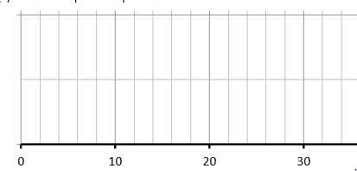
Solutions to questions
Find the interquartile range of the following data and draw a boxplot
7 3 21 9 4 2 21 8
First put the data in order 2 3 4 7 8 9 21 21
Then find middle values 2 3 4 7 8 9 21 21
Median = 7.5, Lower quartile = 3.5, Upper quartile = 15, Interquartile range = 15 – 3.5 = 11.5

Slide 13
Solutions to questions
The following data summarises the weight of items of luggage on an aircraft. Draw a boxplot to show this data. What is the interquartile range?
Interquartile range = 21 – 16 = 5

Slide 14
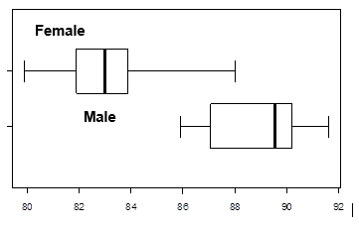
Problem solving and reasoning
100 students, 50 male and 50 female were given a puzzle, and the time they took to complete it was recorded in seconds. These boxplots show this data.
Compare the male and female completion times.

Slide 15
Problem solving and reasoning
100 students, 50 male and 50 female were given a puzzle, and the time they took to complete it was recorded in seconds. These boxplots show this data.
Compare the male and female completion times.
As a minimum you always compare
1 An average – the median
2 A measure of how spread out the data is
This means either comparing the range
or comparing the interquartile range
You should always compare the numbers, then
say what that means in the context of the
question
The median average is much smaller for females than for males (about
83 compared to about 89).
Females are quicker on average.
The interquartile range for females is smaller (2) than males (3).
Females are less varied in the time they take.

