Slide 1
Calculate with Fractions
Grade C
Calculate with fractions including problem solving
If you have any questions regarding these resources or come across any errors, please contact
helpful-report@pixl.org.uk

Slide 2
Key Vocabulary
Numerator
Denominator
Equivalent
Improper Fraction
Mixed Number
Simplify

Slide 3
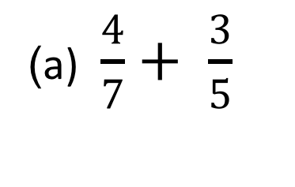
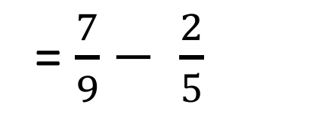
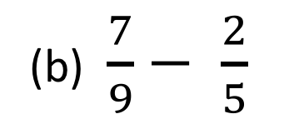

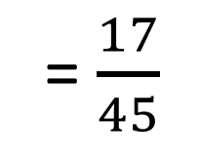
How to add/subtract fractions...
(a) $\frac{4}{7}+ \frac{3}{5}$
Denominators must be the same!
(b) $\frac{7}{9}− \frac{2}{5}$
= $\frac{4}{7}+ \frac{3}{5}$
= $\frac{7}{9}− \frac{2}{5}$
x 5
x 7
Make each fraction an equivalent fraction with a common denominator
x 5
x 9
x 7
x 5
x 9
x 5
= $\frac{20}{35}+ \frac{21}{35}= \frac{20+21 }{35}$
= $\frac{35}{45}− \frac{18}{45}= \frac{35−18 }{45}$
Only add the numerators
Only subtract the numerators
= $\frac{41}{35}=1\frac{6}{35}$
= $\frac{17}{45}$
Leave in simplest form

Slide 4
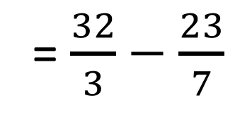
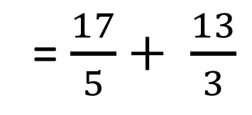
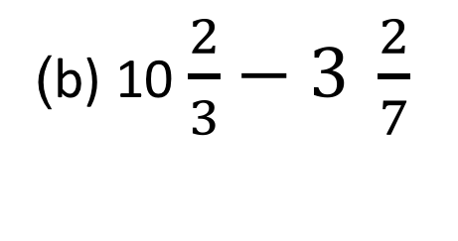
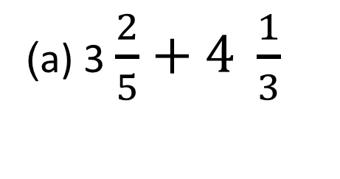
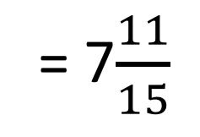
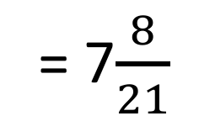
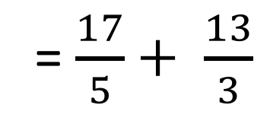
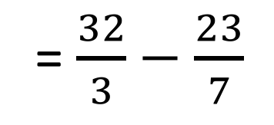
How to add/ subtract mixed numbers...
(a) 3 $\frac{2}{5}+4 \frac{1}{3}$
Denominators must be the same!
(b) 10 $\frac{2}{3}−3 \frac{2}{7}$
= $\frac{17}{5}+ \frac{13}{3}$
Convert to improper fractions
= $\frac{32}{3}−\frac{23}{7}$
x 3
= $\frac{32}{3}−\frac{23}{7}$
= $\frac{17}{5}+ \frac{13}{3}$
x 5
x 7
x 3
x 3
x 5
x 7
x 3
= $\frac{51}{15}+ \frac{65}{15}= \frac{116 }{15}$
= $\frac{224}{21}−\frac{69}{21}= \frac{155 }{21}$
Only add the numerators
Only subtract the numerators
= 7$\frac{11}{15}$
= 7$\frac{8}{21}$
Leave in simplest form

Slide 5
How to multiply by a fraction...
We can cross cancel to make things easier but you do not have to!
(We can just multiply the numerators and multiply the denominators)
21 5
÷7
10 7
×
÷7
Look diagonally to spot common factors!
3 5
10 1
=
×
2
6 1
3 5
×
10 1
÷5
=
=
= 6
1
÷5

Slide 6
How to multiply by a fraction
Find 2/9 of 108
There are two ways of answering this question
‘Divide by the bottom then multiply by the top’
‘Of is the same as multiply’
108 ÷ 9 = 12
12 x 2
= 24
=24

Slide 7
How to Divide by a mixed number..
4 7
2 5
2
÷
Firstly change the mixed number to an improper fraction!
18 7
×
5 2
KEEP
CHANGE
FLIP
90 14
6 14
3 7
=
6
=
6

Slide 8
Calculating with fractions now you try..

Slide 9
Calculating with fractions now you try..

Slide 10
Problem solving and reasoning
Austin has gone shopping. He spends 4 ¾ minutes walking from the bus into the town. He then spends 12 $2/5$minutes in ‘supersaves’, 9$3/7$ minutes in ‘station fun’ and then another 18 ½ minutes walking back to the bus stop.
What is the total time he spent in town?

Slide 11
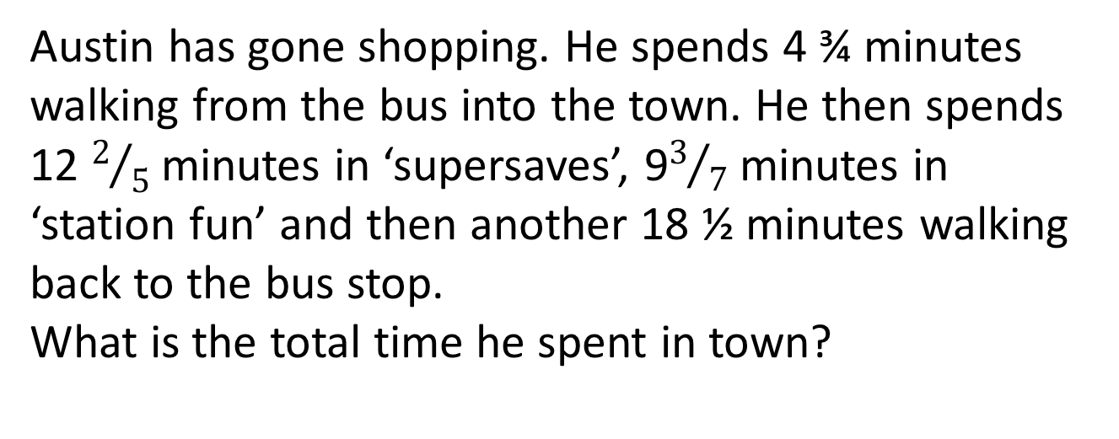
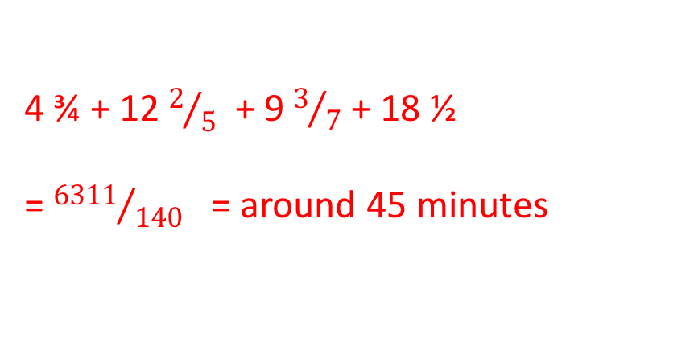
Problem solving and reasoning
Austin has gone shopping. He spends 4 ¾ minutes walking from the bus into the town. He then spends 12 $2/5$minutes in ‘supersaves’, 9$3/7$ minutes in ‘station fun’ and then another 18 ½ minutes walking back to the bus stop.
What is the total time he spent in town?
4 ¾ + 12 $2/5$ + 9 $3/7$ + 18 ½
= ${6311}/{140}$ = around 45 minutes

Slide 12
Reason and explain
Why might we leave answers as a fraction?
Which two methods could you use to answer the question ‘Find 2/7 of 35’
Make a ‘find a fraction of...’ question where the multiplication method would have to be used.

