Slide 1
Area of a Circle
Grade D/E
Recall and use the formula for the area & circumference of a circle

Slide 2
Key Vocabulary
Circle
Diameter
Radius
Circumference
Area
Pi $(π)$

Slide 3
Finding the Area of a Circle
The area is the amount of space taken up by the circle – here is is the amount of blue space.
Circumference
Area = Pi x radius x radius
$$A=π×r×r \\ A=πr^{2}$$
Radius
x
Cherry Pies delicious $\left(C=πd\right)$
Apple Pies are too $(A=πr^{2})$
Diameter
Area

Slide 4
Finding the Area of a Circle - Example
A circle has a radius of 4cm. Find the area of the circle to 1 decimal place.
$$r=4$$
$$A=π×4^{2} \\ A=50.3 cm^{2} (1d.p.)$$
A circle has a diameter of 4cm. Find the area of the circle to 1 decimal place.
$$d=4⇒r=2 \\ A=π×2^{2} \\ A=12.6 cm^{2} (1d.p.)$$

Slide 5

Finding the Circumference of a Circle - Questions
A circle has a radius of 8cm. Find the area of the circle to 1 decimal place.
A circle has a diameter of 18cm. Find the area of the circle to 1 decimal place.
$$r=8$$
$$A=π×8^{2} \\ A=201.1 cm^{2} (1d.p.)$$
$$d=18⇒r=9 \\ A=π×9^{2} \\ A=254.5 cm^{2} (1d.p.)$$

Slide 6
Finding the Diameter/Radius when given the Area - Example
A circle has a area of $12cm^{2}$. Find the radius to 1 decimal place.
$$A=12 \\ 12=πr^{2} \\ r^{2}=\frac{12}{π} \\ r=\sqrt{\frac{12}{π}} \\ r=2.0 (1d.p)$$

Slide 7
Finding the Diameter/Radius when given the Area - Example
A circle has a area of $14cm^{2}$. Find the diameter to 1 decimal place.
$$A=14 \\ 14=πr^{2} \\ r^{2}=\frac{14}{π} \\ r=\sqrt{\frac{14}{π}} \\ r=2.1 \\ d=4.2cm (1d.p.)$$

Slide 8
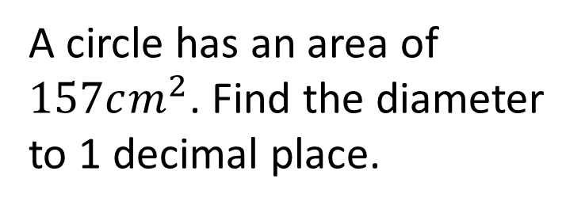
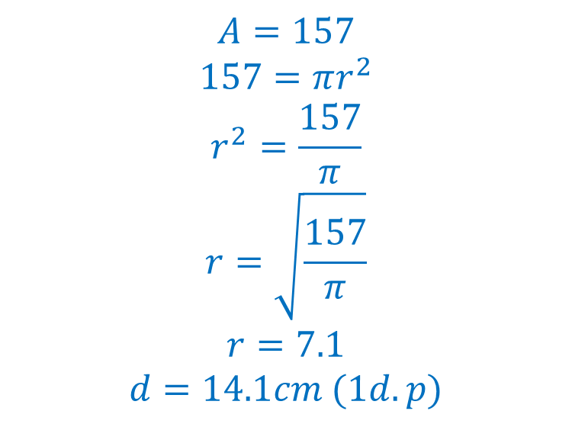

Finding the Diameter/Radius when given the Area- Questions
A circle has an area of $314cm^{2}$. Find the radius to 1 decimal place.
.
A circle has an area of $157cm^{2}$. Find the diameter to 1 decimal place.
$$A=314 \\ 314=πr^{2} \\ r^{2}=\frac{314}{π} \\ r=\sqrt{\frac{314}{π}} \\ r=10.0cm (1d.p)$$
$$A=157 \\ 157=πr^{2} \\ r^{2}=\frac{157}{π} \\ r=\sqrt{\frac{157}{π}} \\ r=7.1 \\ d=14.1cm (1d.p)$$

Slide 9
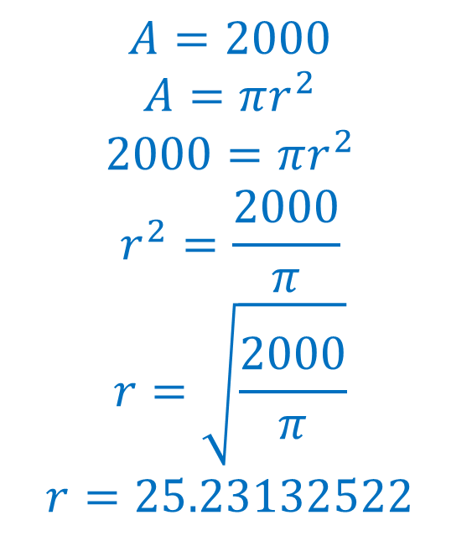
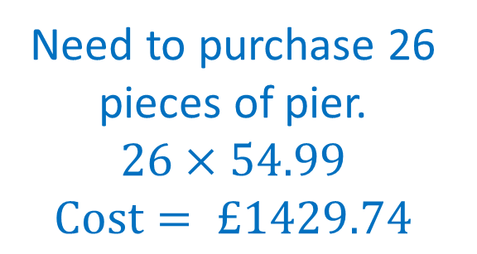
Problem Solving and Reasoning
A local village wants to build a pier to the centre of a circular lake.
The pond takes up an area of $2000m^{2}$. The pier is purchased in metre sections and costs £54.99 per metre. Find the total cost of the pier.
$$A=2000$$
$$A=πr^{2} \\ 2000=πr^{2} \\ r^{2}=\frac{2000}{π} \\ r=\sqrt{\frac{2000}{π}} \\ r=25.23132522$$
Need to purchase 26 pieces of pier.
$$26×54.99 \\ Cost= £1429.74$$

Slide 10
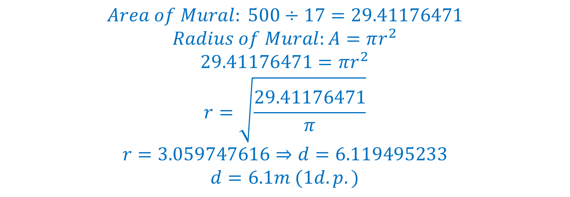
Problem Solving and Reasoning
An artist is painting a mural. The mural is to be painted on a circular canvas. The painter wants the mural to be as large as possible.
Paint costs £17 per square metre and she has a total of £500 to spend on paint.
Find the diameter of the mural to 1 decimal place.
$$Area of Mural: 500÷17=29.41176471$$
$$Radius of Mural:A=πr^{2} \\ 29.41176471=πr^{2} \\ r=\sqrt{\frac{29.41176471}{π}} \\ r=3.059747616⇒d=6.119495233 \\ d=6.1m (1d.p.)$$

