Slide 1
Comparing data using graphs
Grade D/E
Use graphical representations to interpret, analyse and compare the distributions of data sets from univariate distributions (discrete, continuous and grouped)
If you have any questions regarding these resources or come across any errors, please contact
helpful-report@pixl.org.uk

Slide 2
Key Vocabulary
Frequency polygon

Slide 3
Types of graph
There are many different types of graph
In this therapy, we will look at frequency polygons
We will look at cases where two separate populations are graphed in order to make comparisons

Slide 4
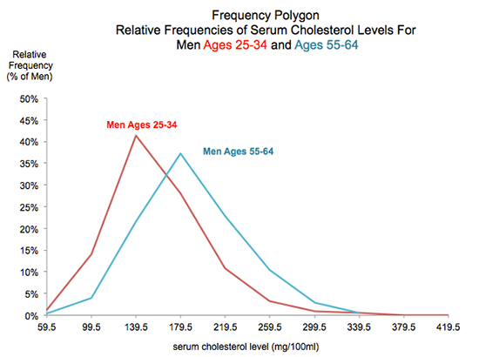
Example – frequency polygon
This is an example taken from a medical research project.
The levels of a particular chemical were measured in two groups of men, one young and one older.

Slide 5
What does the graph tell us?
The range of the chemical present
in the younger group was larger than
for the older group
(419.5 – 59.5 compared to 339.5 – 59.5)
(Note that this is grouped data, so the
actual range will be larger in both cases)
The (median) average value in the
younger group was less than the
older group.
(you can see this as there are more values to the left of the graph for the younger group than for the older group)

Slide 6
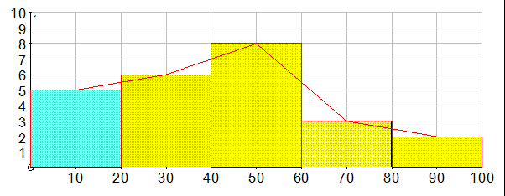
Drawing frequency polygons
Think of drawing a histogram with equal class intervals.
Mark the midpoint of the top of each bar
Join the midpoints up – this is a frequency polygon (purple line only)

Slide 7
Now try these….
Tom and Christine do a lot of driving as part of their job. The table below shows the mileage travelled by both of them over a period of 210 weeks.
Draw a frequency polygon for the two sets of data
Miles | 0 < m ≤ 200 | 200 < m ≤ 400 | 400 < m ≤ 600 | 600 < m ≤ 800
Tom | 20 | 50 | 80 | 60
Christine | 50 | 90 | 40 | 20

Slide 8
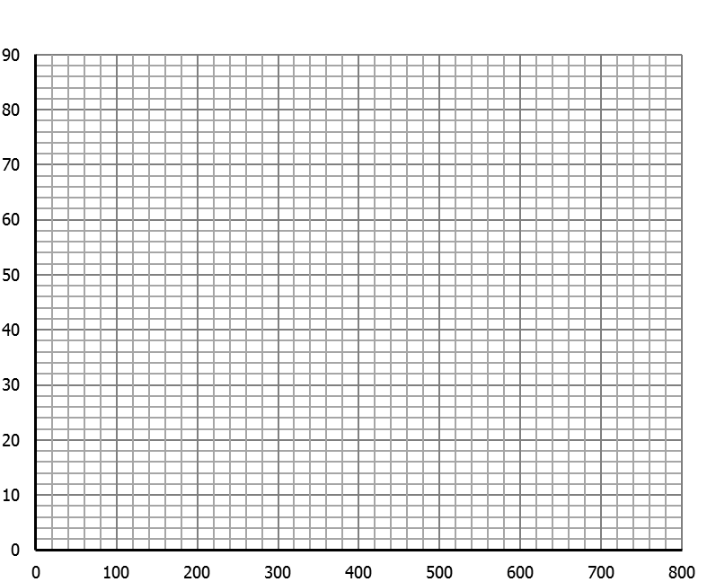
Now try these….

Slide 9
Now try these….
Now use your graph to compare the mileage driven by these two people

Slide 10
Now try these….solutions
Tom
Christine
Frequency
Mileage

Slide 11
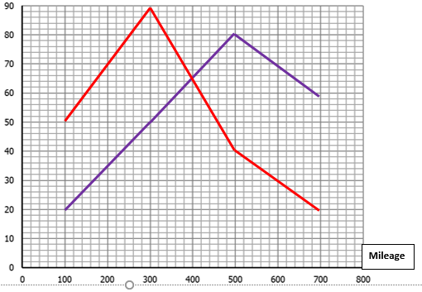
Now try these….solutions
Now use your graph to compare the mileage driven by these two people
Christine drives a lot less than Tom.
Much more of the high values in her
graph are to the left compared with
Tom
The range of Christine’s mileage is the same as Tom’s

