Slide 1
Terminating decimals and fractions
Grade C
Convert between and work with terminating decimals and their equivalent fractions (including ordering).
If you have any questions regarding these resources or come across any errors, please contact
helpful-report@pixl.org.uk

Slide 2
Key vocabulary
Fraction
Terminate
Recurring
Decimal
Equivalent

Slide 3
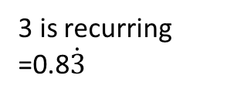
How to identify a terminating decimal and their equivalent fractions
Change the following fractions into decimals and identify whether the decimal terminates or recurs:
1) $\frac{3}{8}$ 2) $\frac{5}{6}$
Is the same as 3÷8
Is the same as 5÷6
0 . 3 7 5
8) 3 .0 0 0
- 0
3 0
- 2 4
6 0
- 5 6
4 0
- 4 0
0
0 . 8 3 3…..
6) 5 .0 0 0
- 0
5 0
- 4 8
2 0
- 1 8
2 0
- 1 8
2
3 is recurring
=0.8$\dot{3}$
8x3=24
6x8=48
8x7=56
6x3=18
8x5=40
6x3=18
Terminating decimal:
A decimal that has finite numbers and ends
Recurring decimal:
A decimal fraction in which a figure or group of figures repeat indefinitely

Slide 4
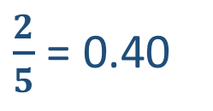
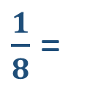
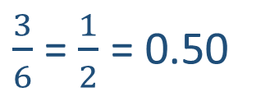
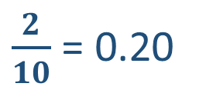
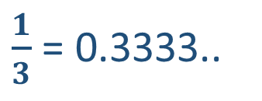
How to identify a terminating decimal and their equivalent fractions
Order the following fractions starting with the smallest
$\frac{2}{5}$ $\frac{1}{8}$ $\frac{1}{3}$ $\frac{2}{10}$ $\frac{3}{6}$
Start by converting each fraction into a decimal
$\frac{1}{3}$ = 0.3333..
$\frac{2}{10}$ = 0.20
$\frac{1}{8}$ =
0 . 1 2 5
8) 1 .0 0 0
- 0
1 0
- 8
2 0
- 1 6
4 0
- 4 0
0
$\frac{2}{5}$ = 0.40
$\frac{3}{6}$ =$\frac{1}{2}$ = 0.50
8x1=8
8x2=16
8x5=40
In order: $\frac{1}{8}$ $\frac{2}{10}$ $\frac{1}{3}$ $\frac{2}{5}$ $\frac{3}{6}$

Slide 5
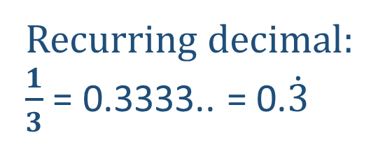
How to identify a terminating decimal and their equivalent fractions
Identify which of the following fractions are terminating decimals:
$\frac{2}{5}$ $\frac{1}{8}$ $\frac{1}{3}$ $\frac{2}{10}$ $\frac{3}{6}$
Terminating decimals:
$\frac{1}{8}$ = 0.125 $\frac{2}{10}$ = 0.20 $\frac{2}{5}$ = 0.40 $\frac{3}{6}$ =$\frac{1}{2}$ = 0.50
Recurring decimal:
$\frac{1}{3}$ = 0.3333.. = 0.$\dot{3}$

Slide 6
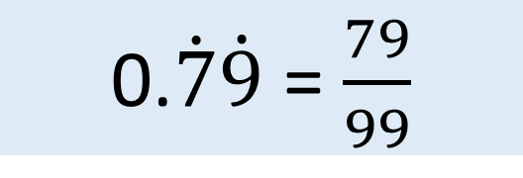

How to change recurring decimals into fractions
Change 0.$\dot{7}\dot{9}$ into a fraction
Let X = 0.7979797979……
Two numbers are recurring so multiply by 100 and
100X = 79.797979797……
- X = 0.7979797979……
99X = 79
X = $\frac{79}{99}$
Subtract the two
Divide both sides by 99
0.$\dot{7}\dot{9}$ = $\frac{79}{99}$

Slide 7
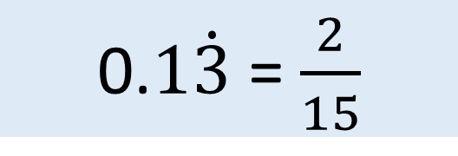

How to change recurring decimals into fractions
Change 0.$1\dot{3}$ into a fraction
Let X = 0.$1\dot{3}$ 10X = 1. $\dot{3}$ 100X = 13. $\dot{3}$
100X = 13.33333333……
- 10X = 1.333333333……
90X = 12
X = $\frac{12}{90}$ = $\frac{2}{15}$
Subtract the two
Divide both sides by 90
÷ 6
Simplify the fraction
÷ 6
0.$1\dot{3}$ = $\frac{2}{15}$

Slide 8
Terminating decimals and their equivalent fractions- Now you try…
(i) Convert the following fractions into decimals
$\frac{1}{7}$ $\frac{18}{12}$ $\frac{3}{11}$ $\frac{1}{25}$ $\frac{3}{5}$
(ii) identify each terminating decimals.
Convert the following fractions into decimals
(i) $\frac{71}{4}$ (ii) $\frac{19}{30}$
Which fractions are terminating?
$\frac{4}{15}$ $\frac{9}{8}$ $\frac{21}{50}$
Change 0. $\dot{9}\dot{1}$ into a fraction
Convert the following fractions into decimals and order them starting with the smallest
$\frac{22}{3}$ $\frac{2}{3}$ $\frac{4}{10}$ $\frac{8}{16}$ $\frac{3}{4}$

Slide 9
Terminating decimals and their equivalent fractions- Now you try…
(i) Convert the following fractions into decimals
$\frac{1}{7}$ $\frac{18}{12}$ $\frac{3}{11}$ $\frac{1}{25}$ $\frac{3}{5}$
(ii) identify each terminating decimals.
Convert the following fractions into decimals
(i) $\frac{71}{4}$ (ii) $\frac{19}{30}$
Which fractions are terminating?
$\frac{4}{15}$ $\frac{9}{8}$ $\frac{21}{50}$
Change 0. $\dot{9}\dot{1}$ into a fraction
Convert the following fractions into decimals and order them starting with the smallest
$\frac{22}{3}$ $\frac{2}{3}$ $\frac{4}{10}$ $\frac{8}{16}$ $\frac{3}{4}$
= 0.142… = 1.5 = 0.27… = 0.04 =0.60
1.5 0.04 0.60
= 17.75 = 0.6333…..
$\frac{9}{8}$ and $\frac{21}{50}$
0.266… = 1.125 = 0.42
$$\frac{91}{99}$$
= 7.$\dot{3}$ = 0.$\dot{6}$ = 0.40 = 0.50 = 0.75
0.40, 0.50, 0.$\dot{6}$, 0.75, 7.$\dot{3}$

Slide 10
Problem solving and reasoning
Order the following numbers starting with the lowest value
0.2$\dot{3}$ $\frac{2}{ 3}$ 1.2 $\frac{10}{11}$ 0.22 0.914 $\frac{7}{8}$
0.2$\dot{3}$ = 0.233… $\frac{2}{ 3}$ = 0.666… $\frac{7}{8}$ = 0.875 $\frac{10}{11}$ = 0.9090……
Now that all the numbers have been converted into decimals, they can now be ordered starting from the lowest
0.22, 0.2$\dot{3}$, 0.$\dot{6},$ 0.875, 0.$\dot{9}\dot{0}$, 0.914, 1.2

Slide 11
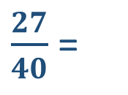
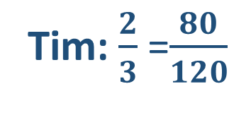
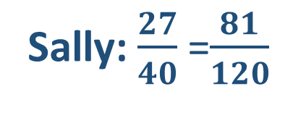
Problem solving and reasoning
Sally and Tim both completed the same Maths quiz.
Sally scored $\frac{27}{40}$
Tim scored $\frac{2}{3}$
Who had the highest result and what is the difference in their score?
$\frac{27}{40}$ =
0 . 6 7 5
40) 2 7 .0 0 0
- 0
2 7 0
- 2 4 0
2 0 0
- 2 8 0
2 0 0
- 2 0 0
0
Sally: $\frac{27}{40}$ =$\frac{81}{120}$
Tim: $\frac{2}{3}$ =$\frac{80}{120}$
40x6= 240
40x7=280
Sally had the highest result and scored 1 mark more than Tim
40x5=200
$\frac{2}{3}$= 0.66666…..

Slide 12
Reason and explain
What is the difference between a terminating decimal and a recurring decimal?
Explain the difference between 1.$\dot{2}$ and $\frac{5}{4}$

