Slide 1
Non-Standard real life graphs
Grade D/E
Plot and interpret non-standard real life graphs to find approximate solutions to kinematics problems involving distance, speed and acceleration
If you have any questions regarding these resources or come across any errors, please contact
helpful-report@pixl.org.uk

Slide 2
Key Vocabulary
Graph
Distance
Time
Speed
Acceleration
Deceleration
Constant
At rest

Slide 3
How to plot a non-standard real life graph
1) Plot the following journey as a distance-time graph:
A car makes a journey to a town 12km away and then returns.
The car initially travels at 0.6km/h (AB) before coming to rest after 5hrs.
After 3hrs pass (BC), the car travels for a further 4hrs until it reaches the town (CD).
After spending 2hrs in the town (DE), the car returns home in 6hrs (EF).
speed x time = distance
0.6 x 5 = 3km
12km – 3km = 8km
The car travels 12km in 6hrs but in the opposite direction!

Slide 4
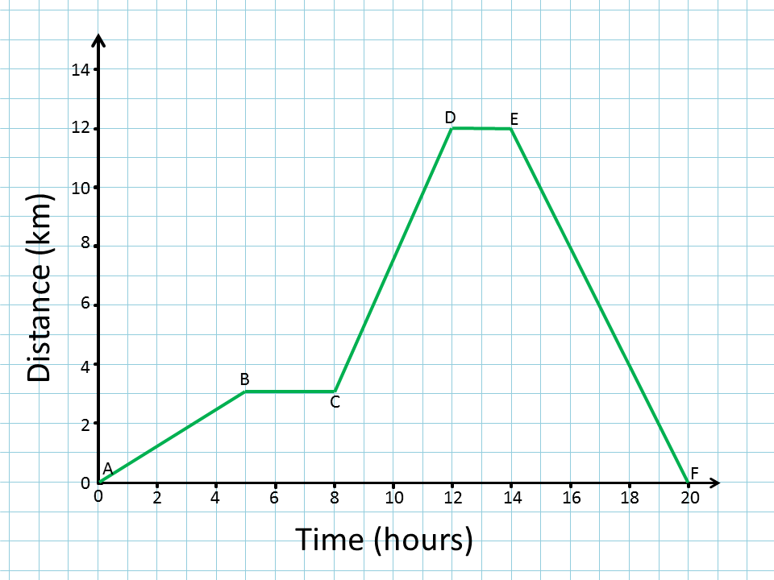
How to plot a non-standard real life graph
1) Now plot this information on the graph
AB) 3km in 5hrs
BC) 0km in 3hrs
CD) 8km in 4hrs
DE) 0km in 2hrs
EF) 12km in 6hrs

Slide 5
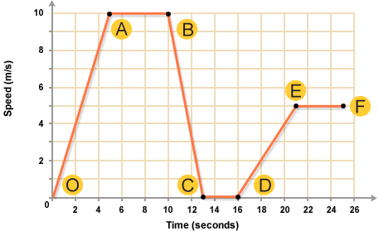
How to use non-standard real life graphs to solve problems
Constant speed
1)
Describe the motion of the bike between each points.
What was the maximum speed of the bike?
What does the gradient represent?
Calculate the maximum acceleration of the bike.
Calculate the total distance travelled by the bike.
Constant speed
Constant acceleration
Constant deceleration
Constant acceleration
stationary
The bike’s speed is constantly increasing with time
The speed remains the same
The speed remains the same
The Bike’s speed is constantly decreasing with time
The bike’s speed is constantly increasing with time
The speed is 0m/s

Slide 6
How to use non-standard real life graphs to solve problems
Constant speed
1)
Describe the motion of the bike between each points.
What was the maximum speed of the bike?
What does the gradient represent?
Calculate the maximum acceleration of the bike.
Calculate the total distance travelled by the bike.
Constant speed
Constant acceleration
Constant deceleration
Constant acceleration
b) 10m/s
c) Change of speed with time i.e. acceleration
stationary
d) The steepest positive gradient occurs between A and O.
Acceleration = gradient = 10/5 = 2m/s²
Total distance travelled = area under the graph
This is because distance = speed x time
e) Total distance = 10(5+13)/2 + 5(4+9)/2 =122.5 m²

Slide 7
How to plot and interpret non-standard real life graph- now you try
A car driving on a road accelerated for 125m in 5 seconds. After reaching its maximum speed, it travelled at a constant velocity for 2 seconds before decelerating to a stop, making the total journey time 8 seconds.
Draw the speed-time graph for the car’s motion, labelling the motion of the car at each stage
Calculate the car’s acceleration
Calculate the car’s total distance travelled

Slide 8
How to plot and interpret non-standard real life graph- now you try
Constant speed
b) Acceleration = gradient = 50/5 = 10m/s²
acceleration
deceleration
c) Distance travelled = total area = 125 + (2 x 50) + (½ x 1 x 50) = 250 m

Slide 9
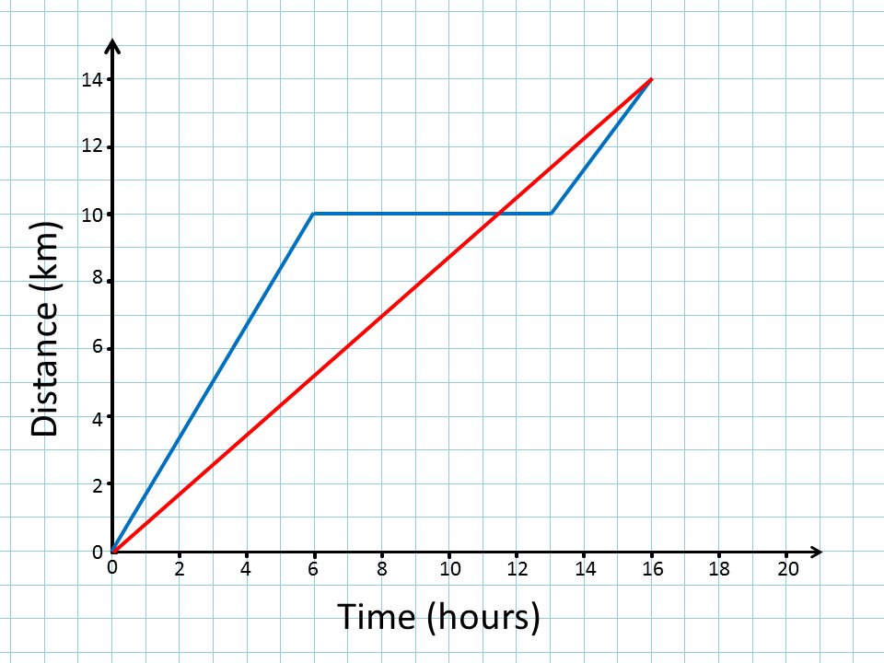
Problem Solving and Reasoning
This graph shows distance against time of two objects.
Describe both graphs at each stage
What was the maximum speed of the blue object?
Assume that the red object continued at the same speed for a further 20 seconds. What would its total distance travelled be?

Slide 10
Problem Solving and Reasoning
This graph shows distance against time of two objects.
Describe both graphs at each stage
What was the maximum speed of the blue object?
Assume that the red object continued at the same speed for a further 20 seconds. What would its total distance travelled be?
stationary
(2) Constant speed
(1) Constant speed
Constant speed
(1) 10km/6hrs = 1.67km/hr
(2) 4km/3hrs = 1.33km/hr
So max speed = 1.67km/hr
Red speed = 14km/16hrs = 0.875 km/hr
As distance = speed x time
Total distance = 0.875 x (16+20) = 31.5km

Slide 11
Reason and explain
How would you show a decreasing acceleration on a speed-time graph?
How would you represent constant speed on an acceleration-time graph?
What does zero acceleration suggest about the speed?

