Slide 1
Plotting straight line graphs
Grade D/E
Plot graphs of straight-lines in the coordinate plane
If you have any questions regarding these resources or come across any errors, please contact
helpful-report@pixl.org.uk

Slide 2
Key Vocabulary
Gradient
Straight line
Graph
Plane
Coordinate
Y-intercept
Equation
Origin

Slide 3
How to complete the values in a table
Complete the table values for y = 3x + 1
What is y when x = -2?
Substituting x = -2 into y = 3x + 1
y = 3 × -2 + 1
y = -6 + 1 = -5
y = - 5
x | -2 | -1 | 0 | 1 | 2
y |  | -2 | 1 |  | 7
-5
4
What is y when x = 1?
Substituting x = 1 into y = 3x + 1
y = 3 × 1 + 1
y = 3 + 1 = 4
y = 4

Slide 4
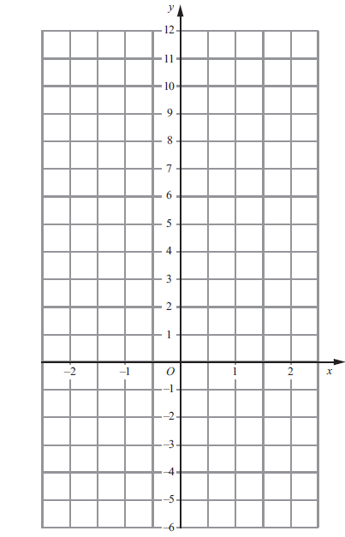
How to plot a straight line graph
Plot the graph of y = 3x + 1
The x-values are the x coordinates and y-values the y coordinates.
So we can plot the points on the graph.
(-2,-5)
(-1,-2)
(0,1)
(1,4)
(2,7)
Finally we can join up each of the crosses with a straight line.
x | -2 | -1 | 0 | 1 | 2
y | -5 | -2 | 1 | 4 | 7

Slide 5
Now you try…
Complete these tables and plot the equations onto a graph…
y = 5x – 3
x | -5 | 0 | 5 | 10 | 15
y | -28 |  |  | 47
y = -x – 4
x | 1 | 2 | 4 | 5 | 7
y |  | -6 |  | -9

Slide 6
Now you try…
Complete these tables and plot the equations onto a graph…
y = 5x – 3
x | -5 | 0 | 5 | 10 | 15
y | -28 |  |  | 47
-3
22
72
y = 5x - 3
y = -x - 4
y = -x – 4
x | 1 | 2 | 4 | 5 | 7
y |  | -6 |  | -9
-5
-8
-11

Slide 7
Problem solving and reasoning
Which of these equations represents which graph?
y = 2x + 5 y = 6x – 1 y = -2x + 2 y = 4x + 6 y = -5x + 10
(0,10)
(0,5)
(0,2)
(1,0)
(2,0)

Slide 8
Problem solving and reasoning
Which of these equations represents which graph?
y = 2x + 5 y = 6x – 1 y = -2x + 2 y = 4x + 6 y = -5x + 10
(0,10)
This is the y-intercept value of each equation.
(0,5)
(0,2)
(1,0)
(2,0)
This equation is y = 2x + 5
This equation is y = -2x + 2
This equation is y = -5x + 10
The y-intercept is where the graph touches the y-axis. So for the first graph it is 5,
second graph it is 2 and third graph it is 10.
So we can see that the first graphs equation must end in +5 therefore the equation is y = 2x + 5.
The second graphs equation must end in +2 so its equation is y = -2x + 2.
And the third graphs equation must be y = -5x + 10

Slide 9
Problem solving and reasoning
Draw the graphs of
y = x
y = -2x
x = 1

Slide 10
Problem solving and reasoning
Draw the graphs of
y = x
y = -2x
x = 1
The graph of y = x does not have a y-intercept so it passes through the origin (0,0) also the y and x values are the same as y = x. So it passes through (1,1), (2,2), (3,3) etc… So we can join them all up with a straight line.
y = -2x goes in the opposite direction and also passes through the origin. It also passes through (1,-2), (2,-4), (3,-6).
x = 1 this is a vertical line because all coordinates on that line have an x value of 1.

Slide 11
Reason and explain
1) Does a straight line have to cross both the x and the y axis?
What is the y-intercept of the equation y = 2x + 5
Is the answer (0,5)?
3) Does the graph of y = -2x + 5 look like this?
(0,5)

