Slide 1
Correlation
Grade D/E
Recognise and describe correlation
If you have any questions regarding these resources or come across any errors, please contact
helpful-report@pixl.org.uk

Slide 2
Key Vocabulary
Positive correlation
Negative correlation
No correlation
Bivariate data
Increase
Decrease

Slide 3
Correlation
Bivariate data is data that has two numbers connected to each data point
Correlation is the word we use to describe how connected the two variables are in bivariate data
For example, we might survey a number of people and measure their height and weight.
The amount of connection between the two variables is called the correlation between the two variables

Slide 4
Scatter diagrams and types of correlation
We usually plot bivariate data on a scatter diagram
This is an easy way to see what type of correlation is present

Slide 5
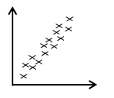
Positive correlation
As one variable increases, so does the other.
For example, weight and height.
Taller people tend to weigh more.

Slide 6
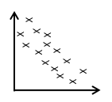
Negative correlation
If one variable increases, the other decreases.
For example, sales of heavy winter clothing and temperature.
As it gets hotter, people buy less heavy clothing.

Slide 7
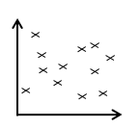
No correlation
Sometimes it seems that the variables are unconnected.
For example sales of batteries and sales of ice-cream
One variable shouldn’t affect the other.

Slide 8
Correlation and numbers
We can calculate a number for correlation -don’t worry, you won’t have to do this – it’s very complicated.
You do however, need to know a few facts.
Correlation lies between -1 and 1.

Slide 9
What do the numbers mean?
Positive correlation
The nearer the number is to 1, the ‘better’ the positive correlation is
Negative correlation
The nearer the number is to -1, the ‘better’ the negative correlation is
No correlation
The nearer the number is to 0, the more likely it is that there is no correlation

Slide 10
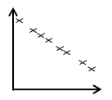
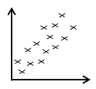
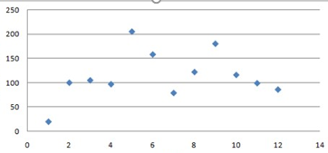
Now try these….
State the type of correlation on these diagrams.
(b)
(c)

Slide 11
Now try these….solutions
State the type of correlation on these diagrams.
(b)
Negative Positive
(c)
No correlation

